Slide 1
OPERATING SYSTEMS(BCS303) Module 1

Slide 2
What is operating systems
Operating system − a program that acts as an intermediary between a user of a computer and the computer hardware.
Operating system goals:
Execute user programs and make solving user problems easier.
Make the computer system convenient to use.
Use the computer hardware in an efficient manner

Slide 3
What is operating systems
The most important program that runs on your computer.
It manages all other programs on the machine.
It performs basic tasks, such as
Recognizing input from the keyboard or mouse
Sending output to the monitor.
Keeping track of files and directories on the disk and
Controlling peripheral devices such as disk drives
and printers
Examples of operating systems that are widely
used are windows, linux, ubuntu, Mac os X and ios , Android

Slide 4
What is operating systems
An operating system is a program that manages the computer hardware. It also provides a basis for application programs and acts as an intermediary between the computer user and the computer hardware.
An Operating System, or OS, is low-level software that enables a user and higher-level application software to interact with a computer’s hardware and the data and other programs stored on the computer.

Slide 5
Types of OS
Batch OS
Time-sharing OS
Distributed OS
Network OS
Real time OS
Multi programming
/Tasking/processing OS
Goals of OS
Convenient
Efficiency
Both
Functions of OS
It is an interface between user and hardware
Allocation of resources
Management of memory, security etc

Slide 6
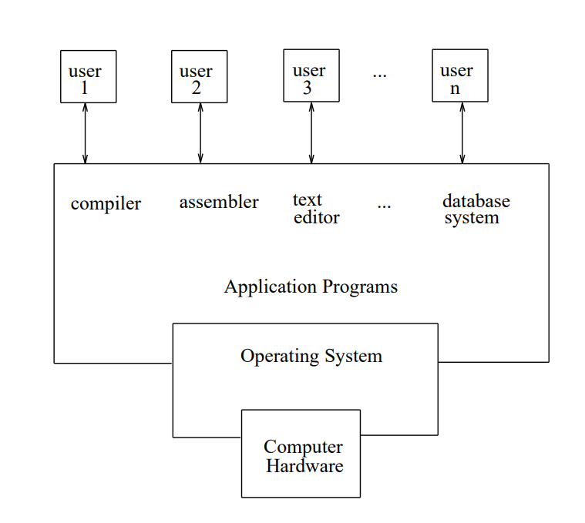
What Operating Systems Do?
A computer system can be divided roughly into four components: the hardware, the operating system, the application programs, and the users (as shown in figure)
Abstract view of the components of a computer system.

Slide 7
Computer System Components Computer system can be divided into four components
1. Hardware − provides basic computing resources (CPU, memory, I/O devices).
2. Operating system − controls and coordinates the use of the hardware among the various application programs for the various users.
3. Applications programs − define the ways in which the system resources are used to solve the computing problems of the users (compilers, database systems, video games, business programs).
4. Users (people, machines, other computers)

Slide 8
The hardware-the central processing unit (CPU), the memory, and the input/output (I/O) devices-provides the basic computing resources for the system.
The application programs-such as word processors, spreadsheets, compilers, and web browsers-define how these resources are used to solve users' computing problems.
The operating system controls and coordinates the use of the hardware among the various application programs for the various users.
The role of the operating system can be seen in two viewpoints:-
User view
System view

Slide 9
User View
The user's view of the computer varies according to the interface being used. Most computer users sit in front of a PC, consisting of a monitor, keyboard, mouse, and system unit.
Such a system is designed for one user to monopolize its resources.
The goal is to maximize the work (or play) that the user is performing.
Ease of use
Resource Utilization.

Slide 10
User View
In other cases, a user sits at a terminal connected to a mainframe or minicomputer. Other users are accessing the same computer through other terminals.
These users share resources and may exchange information. The operating system in such cases is designed to maximize resource utilization to assure that all available CPU time, memory, and I/O are used efficiently and that no individual user takes more than her fair share.

Slide 11
User View
In still other cases, users sit at workstations connected to networks of other workstations and servers.
These users have dedicated resources at their disposal, but they also share resources such as networking and servers-file. Therefore, their operating system is designed to compromise between individual usability and resource utilization.

Slide 12
System View
In this context, we can view an operating system as a resource allocator.
A computer system has many resources that may be required to solve a problem: CPU time, memory space, file-storage space, I/O devices, and so on.
The operating system acts as the manager of these resources.

Slide 13
System View
A slightly different view of an operating system emphasizes the need to control the various I/O devices and user programs.
An operating system is a control program. A control program manages the execution of user programs to prevent errors and improper use of the computer. It is especially concerned with the operation and control of I/O devices.

Slide 14
Defining Operating Systems
Operating systems exist because they offer a reasonable way to solve the problem of creating a usable computing system.
The fundamental goal of computer systems is to execute user programs and to make solving user problems easier. Toward this goal, computer hardware is constructed. Since bare hardware alone is not particularly easy to use, so application programs are developed.
These programs require certain common operations, such as those controlling the I/O devices. The common functions of controlling and allocating resources are then brought together into one piece of software: the operating system.

Slide 15
Computer-System Organization
Before exploring the details of how computer systems operate, we need a general knowledge of the structure of a computer system.
Computer-System Operation
A modern general-purpose computer system consists of one or more CPUs and a number of device controllers connected through a common bus that provides access to shared memory (as shown in figure).
Each device controller is in charge of a specific type of device (for example, disk drives, audio devices, and video displays).

Slide 16
The CPU and the device controllers can execute concurrently, competing for memory cycles.
To ensure orderly access to the shared memory, a memory controller is provided whose function is to synchronize access to the memory.
For a computer to start running-for instance, when it is powered up or rebooted-it needs to have an initial program to run. This initial program, or bootstrap program.
Typically, it is stored in read-only memory (ROM) or electrically erasable programmable read-only memory (EEPROM), known by the general term firmware, within the computer hardware

Slide 17
It must know how to load the OS and start executing that system.
It must locate and load into memory the OS kernel.
Interrupt
The occurrence of an event is usually signalled by an interrupt from the hardware or software
Hardware may trigger an interrupt at any time by sending a signal to CPU, usually by the way of system bus.
System call or Monitor call
Software may trigger an interrupt by executing a special operation called system call.
When the CPU is interrupted, it stops what it is doing and immediately transfers execution to a fixed location
The fixed location usually contains the starting address where the service routine of the interrupt is located
The interrupt service routine executes
On completion the CPU resumes the interrupted computation

Slide 18
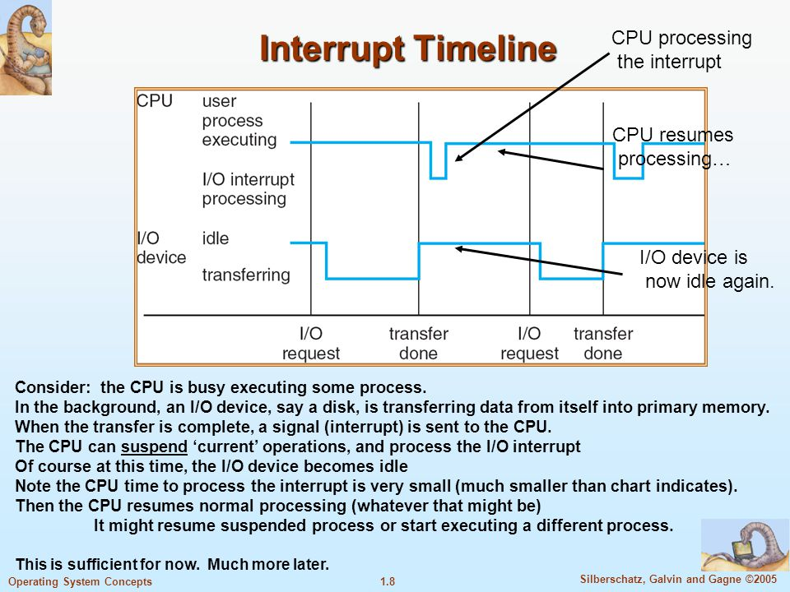

Slide 19
Storage Structure
Computer programs must be in main memory (also called random-access memory or RAM) to be executed.
Main memory is the only large storage area (millions to billions of bytes) that the processor can access directly.
It commonly is implemented in a semiconductor technology called dynamic random-access memory (DRAM), which forms an array of memory words. Each word has its own address.

Slide 20
Storage Structure
Interaction is achieved through a sequence of load or store instructions to specific memory addresses.
The load instruction moves a word from main memory to an internal register within the CPU, whereas the store instruction moves the content of a register to main memory.
Aside from explicit loads and stores, the CPU automatically loads instructions from main memory for execution.

Slide 21
Storage Structure
In a larger sense, however, the storage structure that we have described consisting of registers, main memory, and magnetic disks-is only one of many possible storage systems.
Others include cache memory, CD-ROM, magnetic tapes, and so on.
Each storage system provides the basic functions of storing a datum and of holding that datum until it is retrieved at a later time.
The main differences among the various storage systems lie in speed, cost, size, and volatility.

Slide 22
The wide variety of storage systems in a computer system can be organized in a hierarchy (as shown in figure 6) according to speed and cost.
The higher levels are expensive, but they are fast. As we move down the hierarchy, the cost per bit generally decreases, whereas the access time generally increases.
This trade-off is reasonable; if a given storage system were both faster and less expensive than another-other properties being the same-then there would be no reason to use the slower, more expensive memory

Slide 23
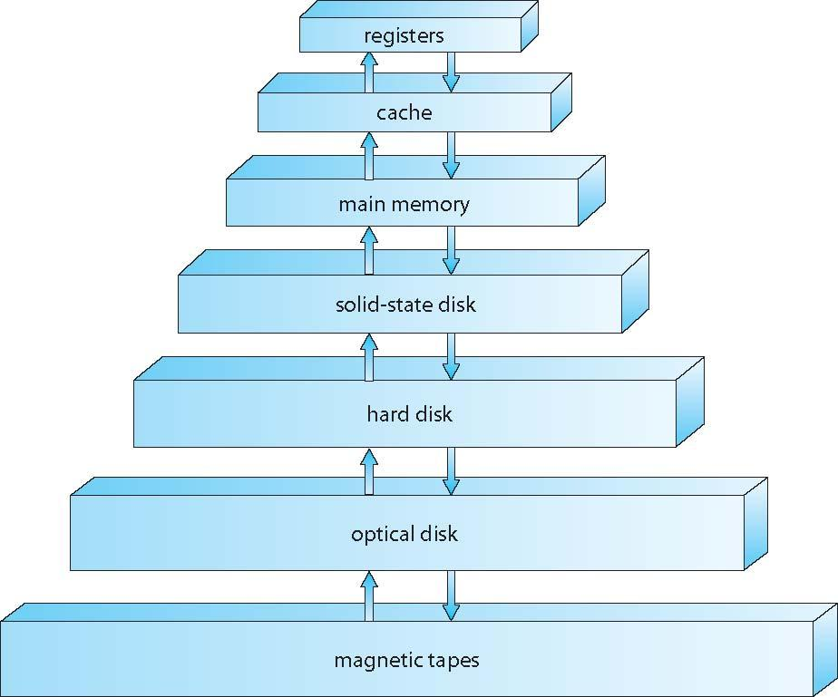
Storage-device hierarchy
Figure 6 Storage-device hierarchy

Slide 24
I/O Structure
Storage is only one of many types of I/O devices within a computer.
A large portion of operating system code is dedicated to managing I/O, both because of its importance to the reliability and performance of a system and because of the varying nature of the devices. Therefore, we now provide an overview of I/O.

Slide 25
I/O Structure
A general-purpose computer system consists of CPUs and multiple device controllers that are connected through a common bus.
Each device controller is in charge of a specific type of device.
Typically operating system have device driver for each device controller.

Slide 26
I/O Structure
A device controller maintains some local buffer storage and a set of special-purpose registers.
The device controller is responsible for moving the data between the peripheral devices that it controls and its local buffer storage.
This driver understands the device controller and presents a uniform interface to the device to the rest of the operating system.

Slide 27
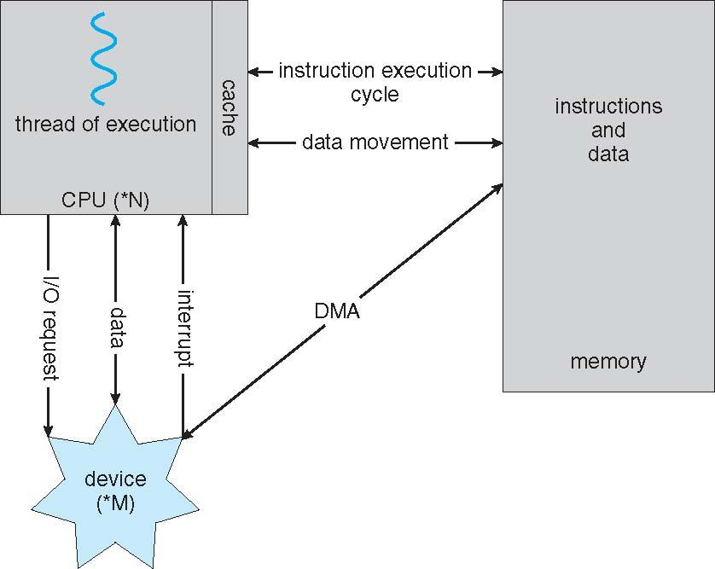
Working of I/O Operation

Slide 28
Working of I/O Operation
To start an I/O operation, the device driver loads the appropriate registers within the device controller.
The device controller, in turn, examines the contents of these registers to determine what action to take (such as "read a character from the keyboard").
The controller starts the transfer of data from the device to its local buffer.

Slide 29
Working of I/O Operation
Once the transfer of data is complete, the device controller informs the device driver via an interrupt that it has finished its operation.
The device driver then returns control to the operating system, possibly returning the data or a pointer to the data if the operation was a read. For other operations, the device driver returns status information.
This form of interrupt driven I/O is fine for moving small amount of data but can produce high overhead when used for bulk data movement.

Slide 30
To solve this problem DMA(Direct memory access) is used.
After setting up buffers, pointers and counter for I/O device, the device controllers transfers an entire block of data directly to or from its own buffer storage to memory, with no intervention by CPU.
Only one interrupt is generated per block, to tell the device drive that the operation is completed.
While the device controller is performing these operations, the CPU is available to accomplish other work.

Slide 31
Computer-System Architecture
A computer system may be organized in a number of different ways, which we can categorize roughly according to the number of general-purpose processors used. It can be classified as shown below:
Single processors system
Multi-processor system
Clustered systems

Slide 32
Single processor system
Most systems use a single processor.
The variety of single-processor systems may be surprising, however, since these systems range from PDAs through mainframes.
On a single-processor system, there is one main CPU capable of executing a general-purpose instruction set, including instructions from user processes. Almost all systems have other special-purpose processors as well.
These special purpose processors performs device specific tasks.

Slide 33
Multiprocessor Systems
Multiprocessor Systems
Although single-processor systems are most common, multiprocessor systems (also known as parallel systems or tightly coupled systems) are growing in importance. Such systems have two or more processors in close communication, sharing the computer bus and sometimes the clock, memory, and peripheral devices.
Multiprocessor systems have three main advantages:
Increased throughput
Economy of scale
Increased reliability

Slide 34
The multiple-processor systems in use today are of two types. Some systems use asymmetric multiprocessing, in which each processor is assigned a specific task.
A master processor controls the system; the other processors either look to the master for instruction or have predefined tasks.
This scheme defines a master-slave relationship. The master processor schedules and allocates work to the slave processors.
The ability to continue providing service proportional to the level of surviving hardware is called graceful degradation
Some systems go beyond graceful degradation and are called fault tolerant, because they can suffer a failure of any single component and still continue operation

Slide 35
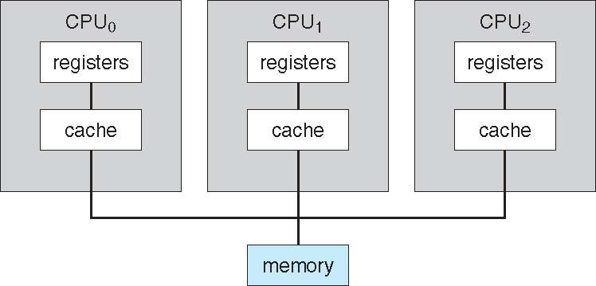
The most common systems use symmetric multiprocessing (SMP), in which each processor performs all tasks within the operating system.
SMP means that all processors are peers; no master-slave relationship exists between processors. Figure illustrates a typical SMP architecture.
Symmetric multiprocessing architecture.

Slide 36
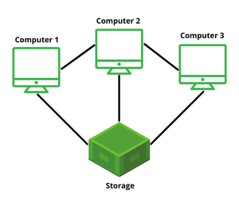
Clustered Systems
Another type of multiple CPU system is the clustered system.
Like multiprocessor systems, clustered systems gather together multiple CPUs to accomplish computational work.
Clustered systems differ from multiprocessor systems, however, in that they are composed of two or more individual systems coupled together called as cluster.
Provides high availability.

Slide 37
Clustered Systems
Clustering can be structured asymmetrically or symmetrically. In asymmetric clustering, one machine is in hot-standby mode while the other is running the applications.
The hot-standby host machine does nothing but monitor the active server. If that server fails, the hot-standby host becomes the active server
In symmetric mode
Two or more hosts run the applications
Monitors each other

Slide 38
Operating-System Structure
An operating system provides the environment within which programs are executed.
Internally, operating systems vary greatly in their makeup.
Commonalities are Multiprogramming and Time sharing(Multi tasking)
Multiprogramming
Multiprogramming is Capability of running multiple programs by the CPU.
A single user cannot, in general, keep either the CPU or the I/O devices busy at all times.

Slide 39
Multiprogramming increases CPU utilization by organizing jobs (code and data) so that the CPU always has one to execute.
The operating system keeps several jobs in memory simultaneously (as shown in figure).
This set of jobs can be a subset of the jobs kept in the job pool-which contains all jobs that enter the system-since the number of jobs that can be kept simultaneously in memory is usually smaller than the number of jobs that can be kept in the job pool.
The operating system picks and begins to execute one of the jobs in memory

Slide 40
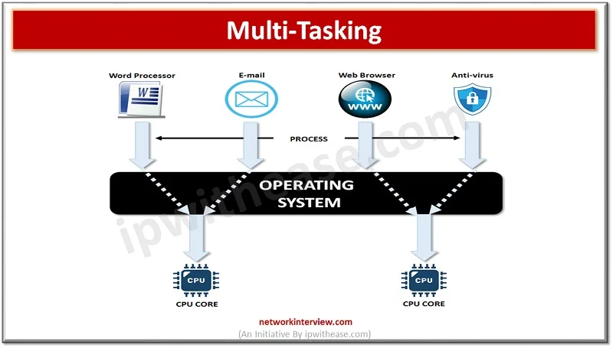
Multiprogrammed systems provide an environment in which the various system resources (for example, CPU, memory, and peripheral devices) are utilized effectively, but they do not provide for user interaction with the computer system.
Time sharing(Multitasking)
Time sharing (or multitasking) is a logical extension of multiprogramming. In time-sharing systems, the CPU executes multiple jobs by switching among them, but the switches occur so frequently that the users can interact with each program while it is running.
Dept. of ISE

Slide 41
Time sharing requires an interactive computer system, which provides direct communication between the user and system.
A time shared OS allows many users to share the computer simultaneously.
In Time shared systems
It uses CPU scheduling and multiprogramming to provide each user with a small portion of time shared computer.
Each user has at least one separate program in memory
A program located into memory and executing is called process.
Dept. of ISE

Slide 42
Operating-System Operations
A modern operating systems are interrupt driven. If there are no processes to execute, no I/O devices to service, and no users to whom to respond, an operating system will sit quietly, waiting for something to happen. Events are almost always signaled by the occurrence of an interrupt or a trap.
A trap is a software-generated interrupt caused either by an error or by a specific request from a user program that an operating-system service be performed.
Dept. of ISE

Slide 43
The interrupt-driven nature of an operating system defines that system's general structure. For each type of interrupt, separate segments of code in the operating system determine what action should be taken. An interrupt service routine is provided that is responsible for dealing with the interrupt.
Since the operating system and the users share the hardware and software resources of the computer system, we need to make sure that an error in a user program could cause problems only for the one program that was running. With sharing, many processes could be adversely affected by a bug in one program.
Dept. of ISE

Slide 44
Dual-Mode Operation
In order to ensure the proper execution of the operating system, we must be able to distinguish between the execution of operating-system code and user defined code. The approach taken by most computer systems is to provide hardware support that allows us to differentiate among various modes of execution.
At the very least, we need two separate modes of operation: user mode and kernel mode (also called supervisor mode, system mode, or privileged mode).
Dept. of ISE

Slide 45
A bit, called the mode bit is added to the hardware of the computer to indicate the current mode: kernel (0) or user (1). With the mode bit, we are able to distinguish between a task that is executed on behalf of the operating system and one that is executed on behalf of the user.
When the computer system is executing on behalf of a user application, the system is in user mode. However, when a user application requests a service from the operating system (via a system call), it must transition from user to kernel mode to fulfill the request. This is shown in Figure 1.8
Dept. of ISE

Slide 46
At system boot time, the hardware starts in kernel mode. The operating system is then loaded and starts user applications in user mode. Whenever a trap or interrupt occurs, the hardware switches from user mode to kernel mode (that is, changes the state of the mode bit to 0). The dual mode of operation provides us with the means for protecting the operating system from errant users-and errant users from one another
The protection is achieved by special machine instructions called privileged instructions.
These instructions are allowed to be executed in kernel mode.
If an attempt is made in user mode the hardware treats it as a trap or an interrupt to the OS and execution mode changes from user to kernel mode.
Dept. of ISE

Slide 47
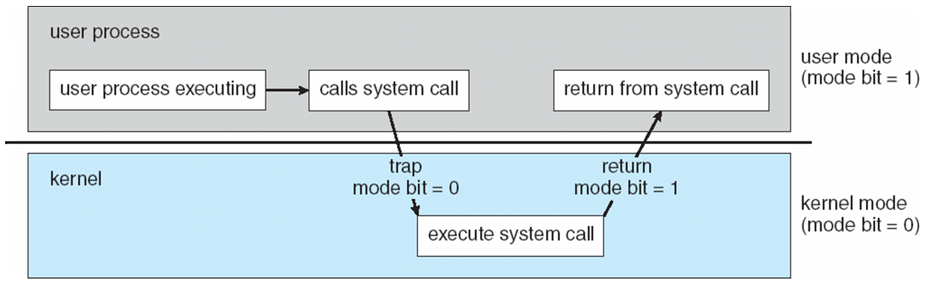
Dept. of ISE

Slide 48
Initial control is within the operating system, where instructions are executed in kernel mode.
When control is given to a user application, the mode is set to user mode. Eventually, control is switched back to the operating system via an interrupt, a trap, or a system call.
When a system call is executed, it is treated by the hardware as a software interrupt. Control passes through the interrupt vector to a service routine in the operating system, and the mode bit is set to kernel mode. The system call service routine is a part of the operating system.
The kernel examines the interrupting instruction to determine what system call has occurred; a parameter indicates what type of service the user program is requesting.
Dept. of ISE

Slide 49
Timer
OS does not allow the user program to get stuck in an infinite loop or to fail to call system services.
A timer can be used to interrupt the computer after specified time period.
The time period can be fixed or variable.
If the timer interrupts the control transfers automatically to OS.
It is treated as either fatal error or may give the program more time.
The instructions to modify the timer are treated as privileged instructions.
Dept. of ISE

Slide 50
In this way timer can be used to prevent the user program from running too long.
A simple technique is to initialize a counter with the amount of time that program is allowed to run.
Every second the timer is interrupted and the counter is decremented by 1.
As long as counter is positive the control is returned to user program.
When the counter becomes negative, the OS terminates the program for exceeding the assigned time limit.
Dept. of ISE

Slide 51
Process Management
A program does nothing unless its instructions are executed by a CPU. A program in execution is called a process.
A time-shared user program such as a compiler is a process.
A word-processing program being run by an individual user on a PC is a process.
A system task, such as sending output to a printer, can also be a process (or at least part of one).
For now, you can consider a process to be a job or a time-shared program, but later you will learn that the concept is more general.
Dept. of ISE

Slide 52
A process needs certain resources-including CPU time, memory, files, and I/O devices-to accomplish its task. These resources are either given to the process when it is created or allocated to it while it is running.
The operating system is responsible for the following activities in connection with process management:
Creating and deleting both user and system processes.
Suspending and resuming processes.
Providing mechanisms for process synchronization
Providing mechanisms for process communication.
Providing mechanisms for deadlock handling.
Dept. of ISE

Slide 53
Memory Management
Main memory is central to the operation of a modern computer system. Main memory is a large array of words or bytes, ranging in size from hundreds of thousands to billions.
Each word or byte has its own address. Main memory is a repository of quickly accessible data shared by the CPU and I/O devices.
The central processor reads instructions from main memory during the instruction-fetch cycle and both reads and writes data from main memory during the data-fetch cycle.
For a program to be executed, it must be mapped to absolute addresses and loaded into memory
Dept. of ISE

Slide 54
The operating system is responsible for the following activities in connection with memory management:
Keeping track of which parts of memory are currently being used and by whom.
Deciding which processes (or parts thereof) and data to move into and out of memory.
Allocating and deallocating memory space as needed.
Dept. of ISE

Slide 55
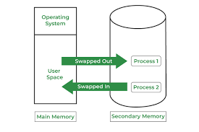
Dept. of ISE

Slide 56
Storage Management
To make the computer system convenient for users, the operating system provides a uniform, logical view of information storage.
The operating system abstracts from the physical properties of its storage devices to define a logical storage unit, the file. The operating system maps files onto physical media and accesses these files via the storage devices.
File-System Management
File management is one of the most visible components of an operating system. Computers can store information on several different types of physical media. Magnetic disk, optical disk, and magnetic tape are the most common.
Dept. of ISE

Slide 57
File management is one of the basic and important feature of OS.
OS is used to manage files of computer system.
All the files different extensions are managed by OS.
File is a collection of related information defined by its creator.
Commonly, files represent programs and data
The operating system is responsible for the following activities in connection with file management:
Creating and deleting files.
Creating and deleting directories to organize files.
Supporting primitives for manipulating files and directories.
Mapping files onto secondary storage.
Backing up files on stable (nonvolatile) storage media.
Dept. of ISE

Slide 58
Mass-Storage Management
As we have already seen, because main memory is too small to accommodate all data and programs, and because the data that it holds are lost when power is lost, the computer system must provide secondary storage to back up main memory. Most modern computer systems use disks to store both programs and data.
Most programs-including compilers, assemblers, word processors, editors, and formatters-are stored on a disk until loaded into memory and then use the disk as both the source and destination of their processing.
Dept. of ISE

Slide 59
Hence, the proper management of disk storage is of central importance to a computer system. The operating system is responsible for the following activities in connection with disk management:
Free-space management.
Storage allocation.
Disk scheduling.
Dept. of ISE

Slide 60
Disk scheduling.
As we know, a process needs two type of time, CPU time and IO time. For I/O, it requests the Operating system to access the disk.
However, the operating system must be fare enough to satisfy each request and at the same time, operating system must maintain the efficiency and speed of process execution.
The technique that operating system uses to determine the request which is to be satisfied next is called disk scheduling.
Dept. of ISE

Slide 61
Caching
Caching is an important principle of computer systems. Information is normally kept in some storage system (such as main memory). As it is used, it is copied into a faster storage system the cache-on a temporary basis. When we need a particular piece of information,
we first check whether it is in the cache. If it is, we use the information directly from the cache; if it is not, we use the information from the source, putting a copy in the cache under the assumption that we will need it again soon.
Dept. of ISE

Slide 62
Because caches have limited size, cache management is an important design problem.
Main memory can be viewed as a fast cache for secondary storage, since data in secondary storage must be copied into main memory for use, and data must be in main memory before being moved to secondary storage for safekeeping
This operation is followed by copying A to the cache and to an internal register. Thus, the copy of A appears in several places: on the magnetic disk, in main memory, in the cache, and in an internal register as shown in the figure.
Dept. of ISE

Slide 63
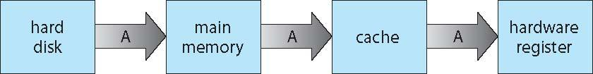
Once the increment takes place in the internal register, the value of A differs in the various storage systems. The value of A becomes the same only after the new value of A is written from the internal register back to the magnetic disk.
Migration of integer A from disk to register.
Dept. of ISE

Slide 64
I/O Systems
One of the purposes of an operating system is to hide the peculiarities of specific hardware devices from the user.
The I/O subsystem consists of several components:
A memory-management component that includes buffering, caching, and spooling.
A general device-driver interface.
Drivers for specific hardware devices.
Dept. of ISE

Slide 65
Protection and Security
If a computer system has multiple users and allows the concurrent execution of multiple processes, then access to data must be regulated. For that purpose, mechanisms ensure that files, memory segments, CPU, and other resources can be operated on by only those processes that have gained proper authorization from the operating system.
Protection and security requires the system to be able to distinguish among all its users.
OS maintains a list of user names and ID’s.
Dept. of ISE
Dept. of ISE

Slide 66
Distributed Systems
A distributed system is a collection of physically separate, possibly heterogeneous computer systems that are networked to provide the users with access to the various resources that the system maintains.
Access to a shared resource increases computation speed, functionality, data availability, and reliability.
Some operating systems generalize network access as a form of file access, with the details of networking contained in the network interface's device driver.
Dept. of ISE

Slide 67
The continuing advent of new technologies brings about new forms of networks. For example, a metropolitan-area network (MAN) could link buildings within a city.
BlueTooth and 802.11 devices use wireless technology to communicate over a distance of several feet, in essence creating a small-area network such as might be found in a home.
Dept. of ISE

Slide 68
Special-Purpose Systems
The discussion thus far has focused on general-purpose computer systems that we are all familiar with. There are, however, different classes of computer systems whose functions are more limited and whose objective is to deal with limited computation domains.
Real-Time Embedded Systems
Embedded computers are the most prevalent form of computers in existence. These devices are found everywhere, from car engines and manufacturing robots to VCRs and microwave ovens. They tend to have very specific tasks.
Dept. of ISE

Slide 69
The systems they run on are usually primitive, and so the operating systems provide limited features.
Usually, they have little or no user interface, preferring to spend their time monitoring and managing hardware devices, such as automobile engines and robotic arms.
The use of embedded systems continues to expand. The power of these devices, both as standalone units and as members of networks and the Web, is sure to increase as well.
Even now, entire houses can be computerized, so that a central computer-either a general-purpose computer or an embedded system-can control heating and lighting, alarm systems, and even coffee makers.
Dept. of ISE

Slide 70
Web access can enable a home owner to tell the house to heat up before she arrives home. Someday, the refrigerator may call the grocery store when it notices the milk is gone.
Embedded systems almost always run real-time operating systems.
A real-time system is used when rigid time requirements have been placed on the operation of a processor or the flow of data; thus, it is often used as a control device in a dedicated application.
Sensors bring data to the computer. The computer must analyze the data and possibly adjust controls to modify the sensor inputs.
Dept. of ISE

Slide 71
Multimedia Systems
Most operating systems are designed to handle conventional data such as text files, programs, word-processing documents, and spreadsheets.
However, a recent trend in technology is the incorporation of multimedia data into computer systems.
Multimedia data consists of audio and video files as well as conventional files.
These data differ from conventional data in that multimedia data-such as frames of video-must be delivered (streamed) according to certain time restrictions (for example, 30 frames per second).
Dept. of ISE

Slide 72
Handheld Systems
Handheld systems include personal digital assistants (PDAs), such as Palm and Pocket-PCs, and cellular telephones, many of which use special-purpose embedded operating systems.
Developers of handheld systems and applications face many challenges, most of which are due to the limited size of such devices.
For example, a PDA is typically about 5 inches in height and 3 inches in width, and it weighs less than one-half pound. Because of their size, most handheld devices have a small amount of memory, slow processors, and small display screens.
Limitations are balanced by their convenience and portability.
Dept. of ISE

Slide 73
Computing Environments
So far, we have provided an overview of computer-system organization and major operating-system components.
We conclude with a brief overview of how these are used in a variety of computing environments.
Traditional Computing
As computing matures, the lines separating many of the traditional computing environments are blurring. Consider the "typical office environment.“
Just a' few years ago, this environment consisted of PCs connected to a network, with servers providing file and print services.
Dept. of ISE

Slide 74
Remote access was awkward, and portability was achieved by use of laptop computers.
Terminals attached to mainframes were prevalent at many companies as well, with even fewer remote access and portability options.
Client-Server Computing
As PCs have become faster, more powerful, and cheaper, designers have shifted away from centralized system architecture. Terminals connected to centralized systems are now being replaced by PCs.
Dept. of ISE

Slide 75
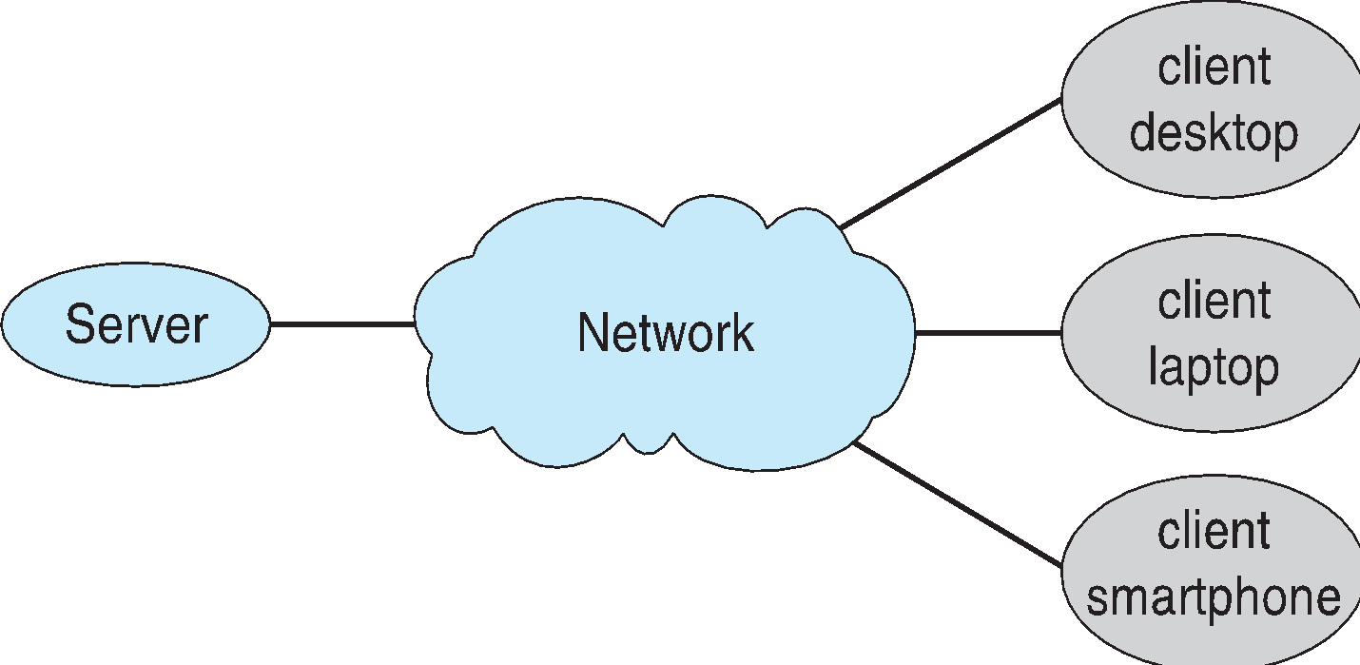
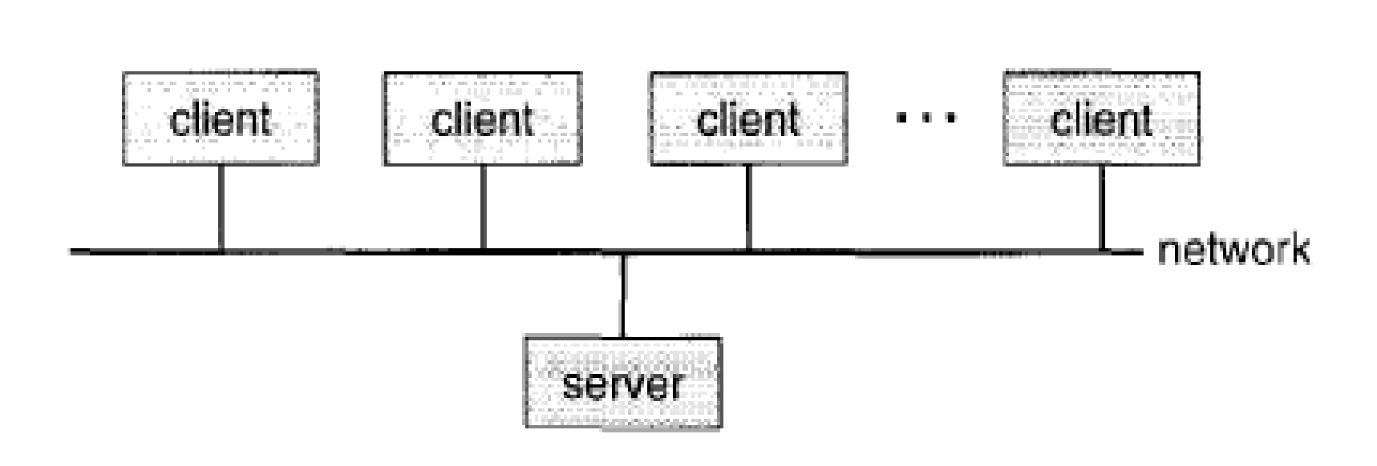
Correspondingly, user interface functionality once handled directly by the centralized systems is increasingly being handled by the PCs. As a result, many of today’s systems act as server systems to satisfy requests generated by client systems. This form of specialized distributed system, called client-server system, has the general structure depicted in figure.
Dept. of ISE

Slide 76
Server systems can be broadly categorized as compute servers and file servers:
The compute-server system provides an interface to which a client can send a request to perform an action (for example, read data); in response, the server executes the action and sends back results to the client.
A server running a database that responds to client requests for data is an example of such a system.
Dept. of ISE

Slide 77
The file-server system provides a file-system interface where clients can create, update, read, and delete files.
An example of such a system is a web server that delivers files to clients running web browsers
Peer-to-Peer Computing
Another structure for a distributed system is the peer-to-peer (P2P) system model. In this model, clients and servers are not distinguished from one another; instead, all nodes within the system are considered peers, and each may act as either a client or a server, depending on whether it is requesting or providing a service.
Dept. of ISE

Slide 78
Peer-to-peer systems offer an advantage over traditional client-server systems. In a client-server system, the server is a bottleneck; but in a peer-to-peer system, services can be provided by several nodes distributed throughout the network.
Peer-to-peer networks gained wide spread popularity in the late 1990s with several file-sharing services, such as Napster and Gnutella, that enable peers to exchange files with one another.
Web-based computing
The Web has become ubiquitous, leading to more access by a wider variety of devices than was dreamt of a few years ago. PCs are still the most prevalent access devices, with workstations, handheld PDAs, and even cell phones also providing access.
Dept. of ISE

Slide 79
Web computing has increased the emphasis on networking.
Devices that were not previously networked now include wired or wireless access. Devices that were networked now have faster network connectivity, provided by either improved networking technology, optimized network implementation code, or both.
The implementation of web-based computing has given rise to new categories of devices, such as load balancers, which distribute network connections among a pool of similar servers.
Dept. of ISE

Slide 80
Operating-System Services
An operating system provides an environment for the execution of programs. It provides certain services to programs and to the users of those programs. The specific services provided, of course, differ from one operating system to another, but we can identify common classes. These operating system services are provided for the convenience of the programmer, to make the programming task easier.
One set of operating-system services provides functions that are helpful to the user. This can be listed as shown below:
Dept. of ISE

Slide 81
User interface: Almost all operating systems have a user interface (UI). This interface can take several forms. One is a command-line interface (CLI), which uses text commands and a method for entering them (say, a program to allow entering and editing of commands). Another is a batch interface, in which commands and directives to control those commands are entered into files, and those files are executed. Most commonly, a graphical user interface (GUI) is used.
Program execution: The operating system must be able to load a program into memory and to run that program. The program must be able to end its execution, either normally or abnormally (indicating error).
Dept. of ISE

Slide 82
I/O operations: A running program may require I/O, which may involve a file or an I/O device. For specific devices, special functions may be desired (such as recording to a CD or DVD drive or blanking a CRT screen). For efficiency and protection, users usually cannot control I/O devices directly. Therefore, the operating system must provide a means to do I/O.
File-system manipulation: The file system is of particular interest. Obviously, programs need to read and write files and directories. They also need to create and delete them by name, search for a given file, and list file information. Finally, some programs include permissions management to allow or deny access to files or directories based on file ownership.
Dept. of ISE

Slide 83
Communications: There are many circumstances in which one process needs to exchange information with another process. Such communication may occur between processes that are executing on the same computer or between processes that are executing on different computer systems tied together by a computer network.
Error detection: The operating system needs to be constantly aware of possible errors. Errors may occur in the CPU and memory and hardware (such as a memory error or a power failure), in I/O devices (such as a parity error on tape, a connection failure on a network, or lack of paper in the printer), and in the user program (such as an arithmetic overflow, an attempt to access an illegal memory location, or a too-great use of CPU time).
Dept. of ISE

Slide 84
Another set of operating-system functions exists not for helping the user but rather for ensuring the efficient operation of the system itself. Systems with multiple users can gain efficiency by sharing the computer resources among the users. This can be listed as shown below:
Resource allocation: When there are multiple users or multiple jobs running at the same time, resources must be allocated to each of them. Many different types of resources are managed by the operating system.
Accounting: We want to keep track of which users use how much and what kinds of computer resources. This record keeping may be used for accounting (so that users can be billed) or simply for accumulating usage statistics.
Dept. of ISE

Slide 85
Protection and security: The owners of information stored in a multiuser or networked computer system may want to control use of that information. When several separate processes execute concurrently, it should not be possible for one process to interfere with the others or with the operating system itself.
Dept. of ISE

Slide 86
User Operating-System Interface
User interface is something that allows the user to interact with the OS
There are two fundamental approaches for users to interface with the operating system.
One technique is to provide a command-line interface or command interpreter that allows users to directly enter commands that are to be performed by the operating system.
The second approach allows the user to interface with the operating system via a graphical user interface or GUI.
Dept. of ISE

Slide 87
Command Interpreter
Some operating systems include the command interpreter in the kernel. Others, such as Windows XP and UNIX, treat the command interpreter as a special program that is running when a job is initiated or when a user first logs on (on interactive systems). On systems with multiple command interpreters to choose from, the interpreters are known as shells. The main function of the command interpreter is to get and execute the next user-specified command. Many of the commands given at this level manipulate files: create, delete, list, print, copy, execute, and so on. The MS-DOS and UNIX shells operate in this way. There are two general ways in which these commands can be implemented.
Dept. of ISE

Slide 88
System Calls
System calls provide an interface to the services made available by an operating system.
System call is programmatic way in which a computer program requests a service from kernel of OS.
These calls are generally available as routines written in C and C
Before we discuss how an operating system makes system calls available, let's first use an example to illustrate how system calls are used: writing a simple program to read data from one file and copy them to another file.
The first input that the program will need is the names of the two files: the input file and the output file. These names can be specified in many ways, depending on the operating-system design
Dept. of ISE

Slide 89
Finally, after the entire file is copied, the program may close both files (another system call), write a message to the console or window (more system calls), and finally terminate normally (the final system call). As we can see, even simple programs may make heavy use of the operating system. Frequently, systems execute thousands of system calls per second. This system call sequence is shown in figure. 2.1.
Dept. of ISE

Slide 90
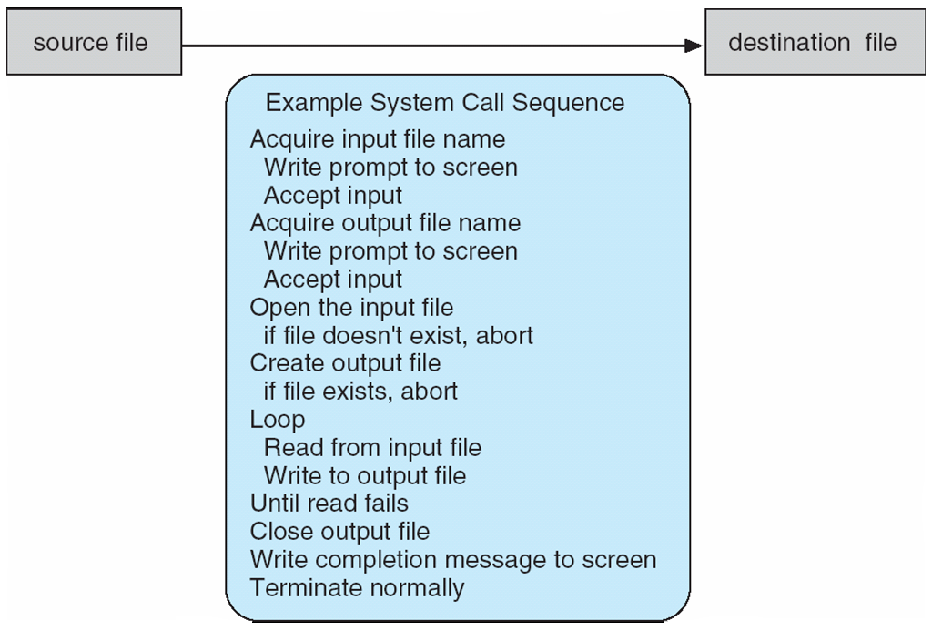
Dept. of ISE
Figure Example of how system calls are used.

Slide 91
Most application developers design programs according to Application Program Interface(API).
The API specifies a set of functions that are available to an application programmers.
Three common used API available to application programmers.
Win32 API- for windows systems.
POSIX API –posix based systems (which includes virtually all versions of UNIX, Linux)
Java API- designing programs that can run on java virtual machine.
Dept. of ISE

Slide 92
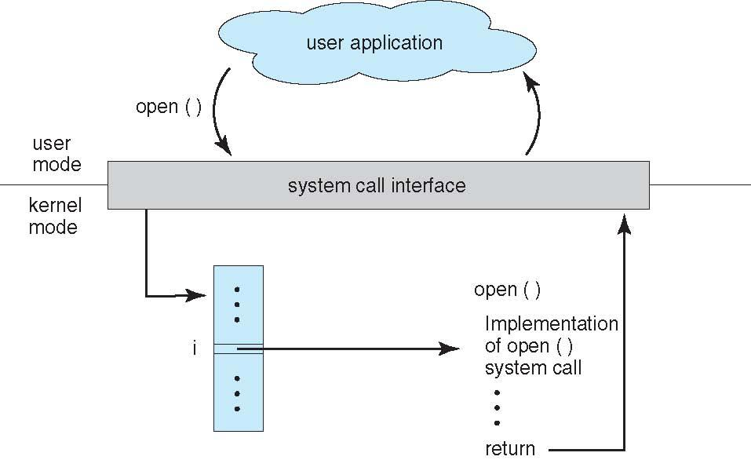
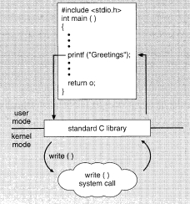
Figure The handling of a user application invoking the open ( ) system call.
The relationship between an API, the system-call interface, and the operating system is shown in Figure 1.13, which illustrates how the operating system handles a user application invoking the open ( ) system call.
Dept. of ISE

Slide 93
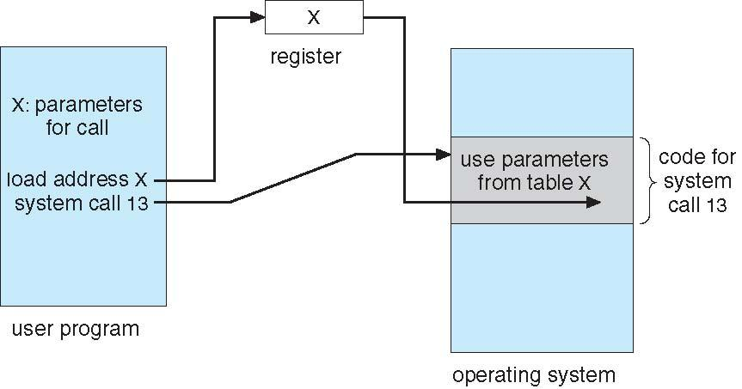
Figure Passing of parameters as a table.
Dept. of ISE

Slide 94
Types of system calls
Process control
create process, terminate process
end, abort
load, execute
get process attributes, set process attributes
wait for time
wait event, signal event
allocate and free memory
Dump memory if error
Debugger for determining bugs, single step execution
Locks for managing access to shared data between processe
Dept. of ISE

Slide 95
File management
create file, delete file
open, close file
read, write, reposition
get and set file attributes
Device management
request device, release device
read, write, reposition
get device attributes, set device attributes
logically attach or detach devices
Dept. of ISE

Slide 96
Information maintenance
get time or date, set time or date
get system data, set system data
get and set process, file, or device attributes
Communications
create, delete communication connection
send, receive messages if message passing model to host name or process name
From client to server
Shared-memory model create and gain access to memory regions
transfer status information
attach and detach remote devices
Dept. of ISE
Protection
Control access to resources
Get and set permissions
Allow and deny user access

Slide 97
System Programs
System programs provide a convenient environment for program development and execution.
Some of them are simply user interfaces to system calls; others are considerably more complex.
Dept. of ISE

Slide 98
They can be divided into these categories:
File management: These programs create, delete, copy, rename, print, dump, list, and generally manipulate files and directories.
Status information. Some programs simply ask the system for the date, time, amount of available memory or disk space, number of users, or similar status information.
File modification: Several text editors may be available to create and modify the content of files stored on disk or other storage devices. There may also be special commands to search contents of files or perform transformations of the text.
Dept. of ISE

Slide 99
Programming-language support. Compilers, assemblers, debuggers and interpreters for common programming languages (such as C, C++, Java, Visual Basic, and PERL) are often provided to the user with the operating system.
Program loading & Execution. Once a program is assembled or complied, it must be loaded into the memory to be executed.
System may provide
Absolute loader
Relocatable loaders
Linkage editors
Over lay loaders.
Debugging systems for either high level languages or machine languages are needed as well
Dept. of ISE

Slide 100
Communications. These programs provide the mechanism for creating virtual connections among processes, users, and computer systems.
They allow users to send messages to one another's screens, to browse web pages, to send electronic-mail messages, to log in remotely, or to transfer files from one machine to another.
Dept. of ISE

Slide 101
In addition to system programs, most operating systems supplied with programs that are useful in solving common problems or performing common operations.
Such programs include web browsers, word processors, and text formatters, spread sheets, databases systems, compliers, plotting.
These programs are known as system utilities or application programs.
Dept. of ISE

Slide 102
There are various key differences between the System Call and System Program in the operating system. Some main differences between the System Call and System Program are as follows:
A user may request access to the operating system's services by using the system call. In contrast, the system program fulfils a common user request and provides a compatible environment for a program to create and run effectively.
The programmer creates system calls using high-level languages like C and C++. Assembly level language is used to create the calls that directly interact with the system's hardware. On the other hand, a programmer solely uses a high-level language to create system programs.
System call defines the interface between the services and the user process provided by the OS. In contrast, the system program defines the operating system's user interface.
Dept. of ISE

Slide 103
The system program satisfies the user program's high-level request. It converts the request into a series of low-level requests. In contrast, the system call fulfils the low-level requests of the user program.
The user process requests an OS service using a system call. In contrast, the system program transforms the user request into a set of system calls needed to fulfil the requirement.
The system call may be categorized into file manipulation, device manipulation, communication, process control, information maintenance, and protection. On the other hand, a System program may be categorized into file management, program loading and execution, programming-language support, status information, communication, and file modification.
Dept. of ISE

Slide 104
Operating-System Design and Implementation
Design Goals
The first problem in designing a system is to define goals and specifications.
At the highest level, the design of the system will be affected by the choice of hardware and the type of system:
Dept. of ISE

Slide 105
Beyond this highest design level, the requirements may be much harder to specify. The requirements can, however, be divided into two basic groups: user goals and system goals.
Users Goals:
The system should be convenient to use, easy to learn and to use, reliable, safe, and fast.
System goals
The system should be easy to design, implement, maintain, operate, it should be flexible, reliable, error free and efficient.
.
Dept. of ISE

Slide 106
Mechanisms and Policies
Mechanisms determine how to do something;
Policies determine what will be done.
One important principle is the separation of policy from mechanism
For example, the timer construct is a mechanism for ensuring CPU protection, but deciding how long the timer is to be set for a particular user is a policy decision.
The separation of policy and mechanism is important for flexibility.
Policies are likely to change across places or over time. In the worst case, each change in policy would require a change in the underlying mechanism.
.
Dept. of ISE

Slide 107
Implementation
Once an operating system is designed, it must be implemented.
Traditionally, operating systems have been written in assembly language.
Now, however, they are most commonly written in higher-level languages such as C or C++.
The advantages of using a higher-level language
The code can be written faster,
It is more compact
It is easier to understand and debug
It is easier to port
Dept. of ISE
Ex: MS DOS was written in intel 8088 assembly language. It is available only on intel family CPUs.
The Linux OS is written in C and is available on a number of different CPUs .

Slide 108
Operating-System Structure
A system as large and complex as a modern operating system must be engineered carefully if it is to function properly and be modified easily.
A common approach is to partition the task into small components rather than have one monolithic system.
Each of these modules should be a well-defined portion of the system, with carefully defined inputs, outputs, and functions.
Dept. of ISE

Slide 109
Simple Structure
MS-DOS is an example of such a system. It was originally designed and implemented by a few people who had no idea that it would become so popular.
It was written to provide the most functionality in the least space, so it was not divided into modules carefully. Figure 1.19 shows its structure.
Dept. of ISE

Slide 110
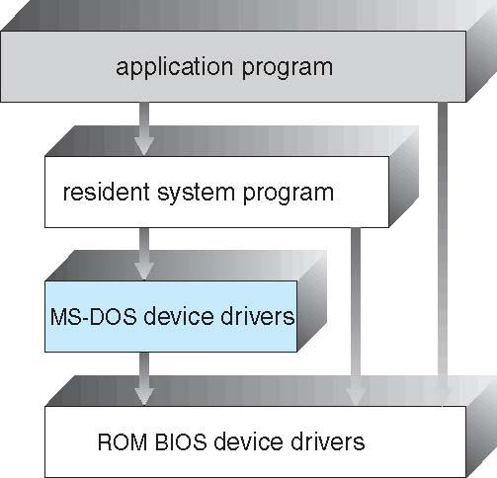
Dept. of ISE
Figure MS-DOS layer structure.

Slide 111
In MS-DOS, the interfaces and levels of functionality are not well separated.
For instance, application programs are able to access the basic I/O routines to write directly to the display and disk drives. Such freedom leaves MS-DOS vulnerable to errant (or malicious) programs, causing entire system crashes when user programs fail.
Of course, MS-DOS was also limited by the hardware of its era.
Dept. of ISE
Notes:
dgfhgj

Slide 112
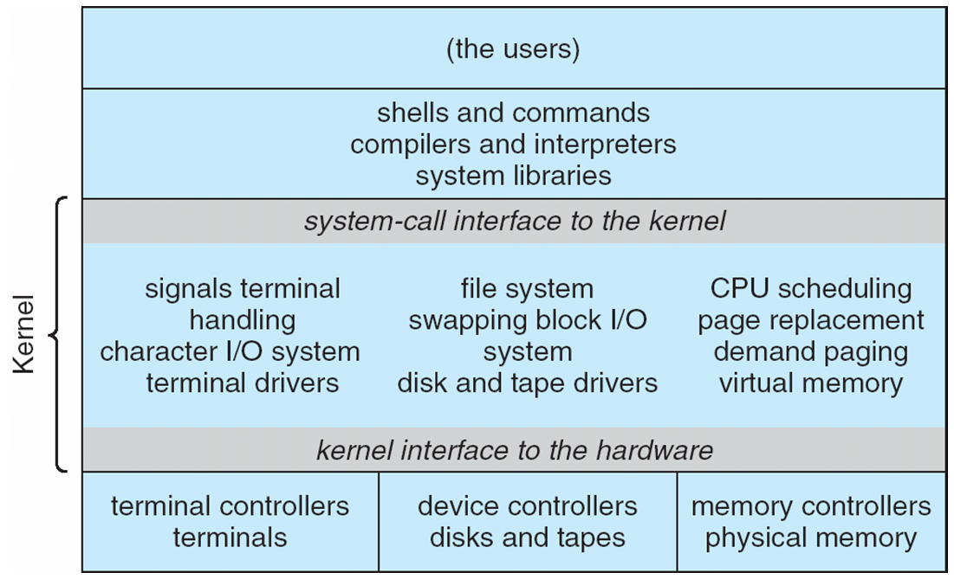
Dept. of ISE
Figure UNIX system structure
This monolithic structure was difficult to implement

Slide 113
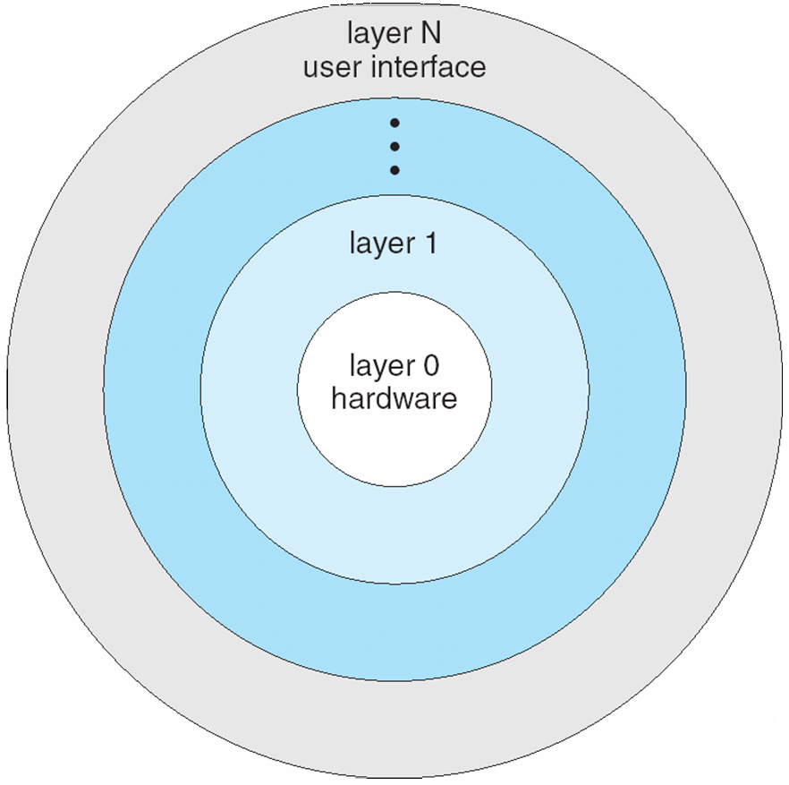
Layered Approach
A system can be made modular in many ways. One method is the layered approach, in which the operating system is broken up into a number of layers (levels). The bottom layer (layer 0) is the hardware; the highest (layer N) is the user interface. This layering structure is depicted in figure
Dept. of ISE
Figure: A layered operating system

Slide 114
Layered Approach
The major difficulty with the layered approach involves appropriately defining the various layers.
Because a layer can use only lower-level layers, careful planning is necessary.
Dept. of ISE

Slide 115
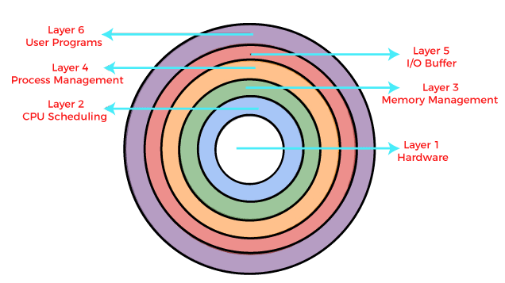
A final problem with layered implementations is that they tend to be less efficient than other types.
For instance, when a user program executes an I/O operation, it executes a system call that is trapped to the I/O layer, which calls the memory-management layer, which in turn calls the CPU-scheduling layer, which is then passed to the hardware.
At each layer, the parameters may be modified, data may need to be passed, and so on.
Each layer adds overhead to the system call; the net result is a system call that takes longer than does one on a non-layered system.
Dept. of ISE

Slide 116
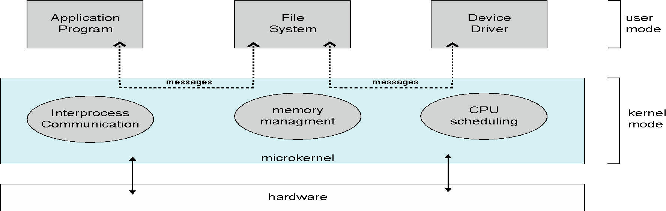
Microkernels
This method structures the operating system by removing all nonessential components from the kernel and implementing them as system and user-level programs.
The result is a smaller kernel. There is little consensus regarding which services should remain in the kernel and which should be implemented in user space. Typically, however, microkernels provide minimal process and memory management, in addition to a communication facility
Dept. of ISE

Slide 117
The main function of the microkernel is to provide a communication facility between the client program and the various services that are also running in user space.
For example, if the client program wishes to access a file, it must interact with the file server. The client program and service never interact directly. Rather, they communicate indirectly by exchanging messages with the microkernel.
Dept. of ISE

Slide 118
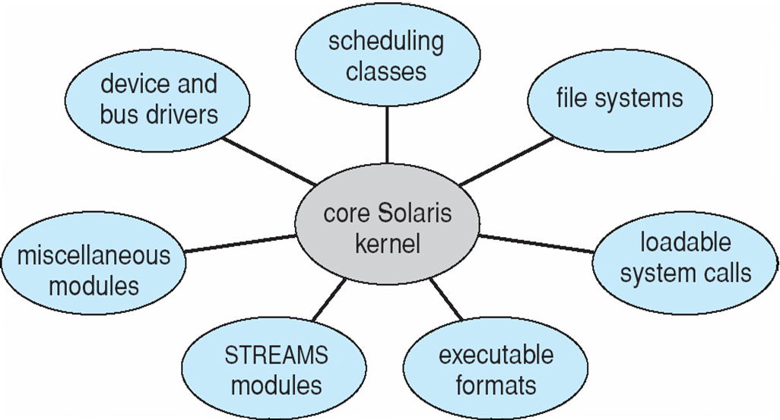
Modules
Perhaps the best current methodology for operating-system design involves using object-oriented programming techniques to create a modular kernel.
Here, the kernel has a set of core components and dynamically links in additional services either during boot time or during run time. Such a strategy uses dynamically loadable modules and is common in modern implementations of UNIX, such as Solaris, Linux, and Mac as x.
Dept. of ISE

Slide 119
Hybrid structure - Mac OS X operating system
The Apple Macintosh Mac OS X operating system uses a hybrid structure.
layered technique where one layer consists of the Mach microkernel. The top layers include application environments and a set of services providing a graphical interface to applications.
Below these layers is the kernel environment, which consists primarily of the Mach microkernel and the BSD kernel.
Mach provides memory management; support for remote procedure calls (RPCs) and interprocesses communication (IPC) facilities, including message passing; and thread scheduling
BSD – Command Line Interface , Networking and file system, POSIX API.
Dept. of ISE

Slide 120
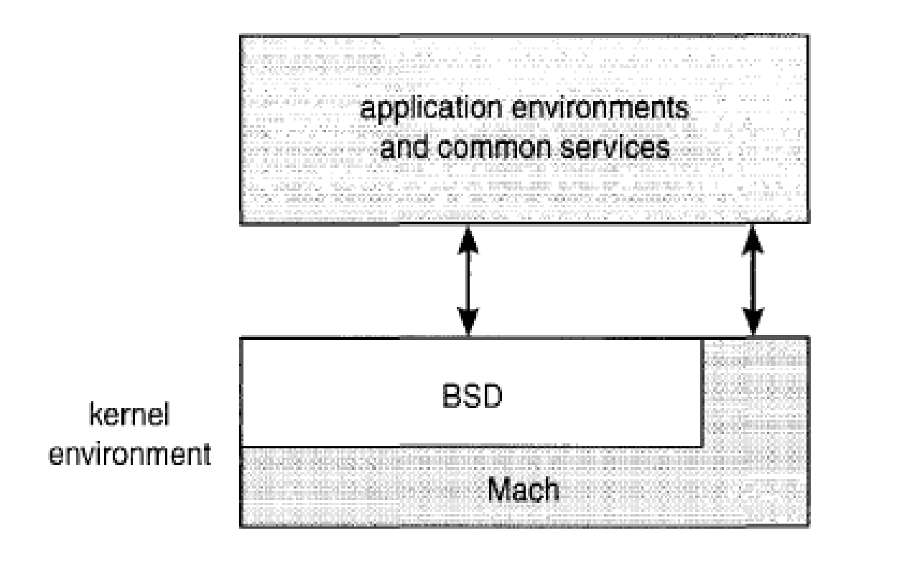
Dept. of ISE
Figure The Mac OS X structure.

Slide 121
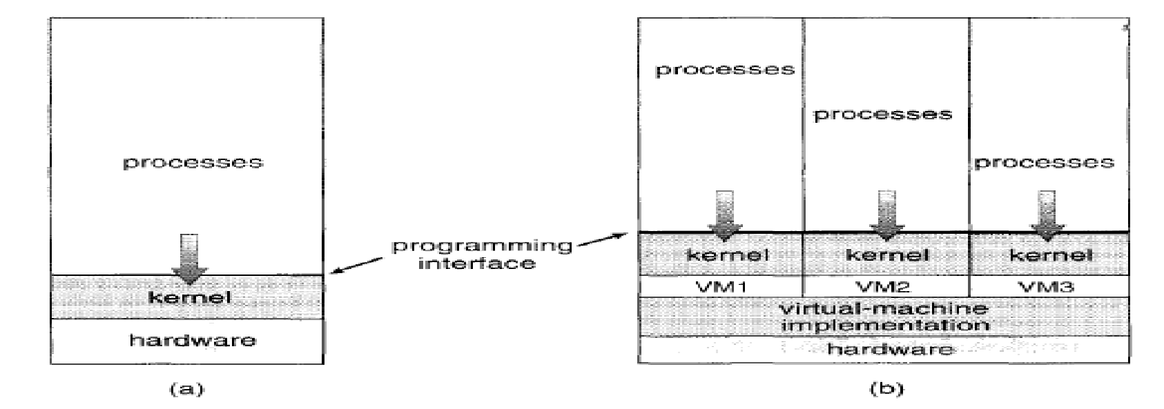
Virtual Machines
Abstract the hardware of a single computer (the CPU, memory, disk drives, network interface cards, and so forth) into several different execution environments, thereby creating the illusion that each separate execution environment is running its own private computer.
Dept. of ISE
(a) Nonvirtual machine. (b) Virtual machine.

Slide 122
Implementation
Although the virtual-machine concept is useful, it is difficult to implement.
Remember that the underlying machine has two modes: user mode and kernel mode. The virtual-machine software can run in kernel mode, since it is the operating system.
The virtual machine itself can execute in only user mode. Just as the physical machine has two modes, however, so must the virtual machine.
Consequently, we must have a virtual user mode and a virtual kernel mode, both of which run in a physical user mode. Those actions that cause a transfer from user mode to kernel mode on a real machine (such as a system call or an attempt to execute a privileged instruction) must also cause a transfer from virtual user mode to virtual kernel mode on a virtual machine.
Dept. of ISE

Slide 123
Benefits
The virtual-machine concept has several advantages.
In this environment, there is complete protection of the various system resources.
Each virtual machine is completely isolated from all other virtual machines, so there are no protection problems.
At the same time, however, there is no direct sharing of resources.
Two approaches to provide sharing have been implemented.
First, it is possible to share a minidisk and thus to share files.
This scheme is modeled after a physical shared disk but is implemented by software.
Second, it is possible to define a network of virtual machines, each of which can send information over the virtual communications network.
This network is modeled after physical communication networks but is implemented in software.
Dept. of ISE

Slide 124
Examples
Despite the advantages of virtual machines, they received little attention for a number of years after they were first developed. Today, however, virtual machines are coming back into fashion as a means of solving system compatibility problems.
There are two popular contemporary virtual machines:
VMware and the Java virtual machine.
These virtual machines typically run on top of an operating system of any of the design types.
Some examples can be listed as
VMware
The JVM
Dept. of ISE

Slide 125
VMware
VMware is a popular commercial application that abstracts Intel 80X86 hardware into isolated virtual machines.
VMware runs as an application on a host operating system such as Windows or Linux and allows this host system to concurrently run several different guest operating systems as independent virtual machines.
The architecture of such a system is shown in Figure.
In this scenario, Linux is running as the host operating system; FreeBSD, Windows NT, and Windows XP are running as guest operating systems.
The virtualization layer is the heart of VMware, as it abstracts the physical hardware into isolated virtual machines running as guest operating systems. Each virtual machine has its own virtual CPU, memory, disk drives, network interfaces, and so forth.
Dept. of ISE

Slide 126
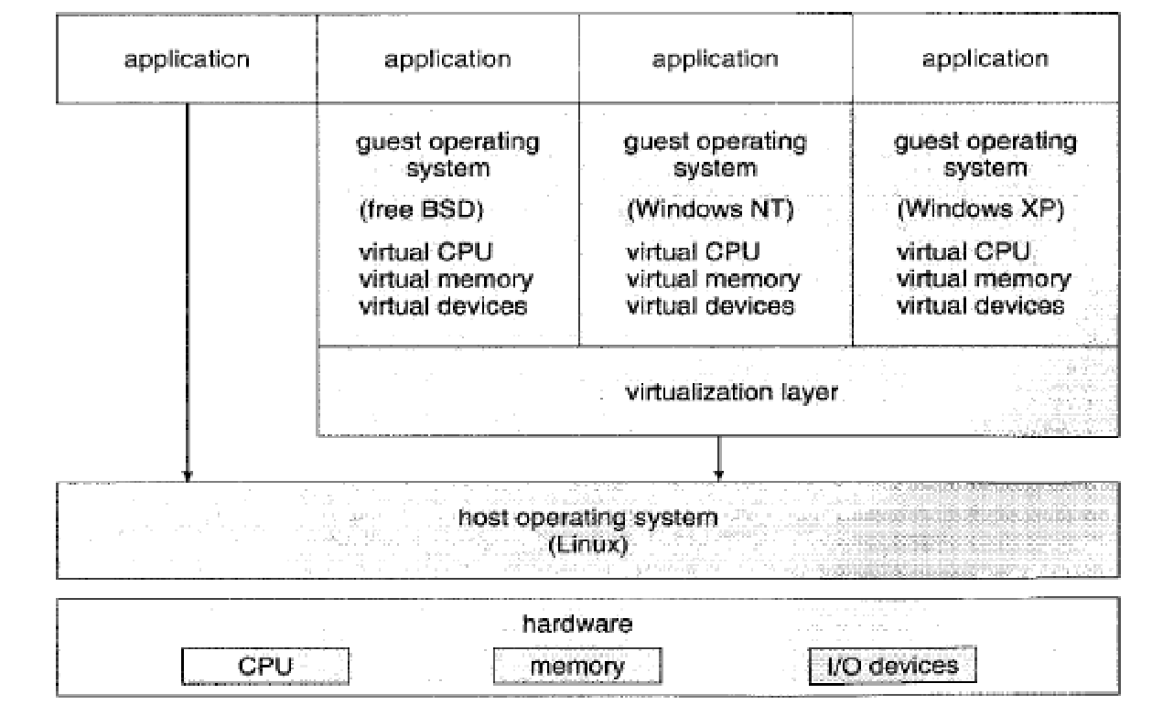
Dept. of ISE
VMware architecture

Slide 127
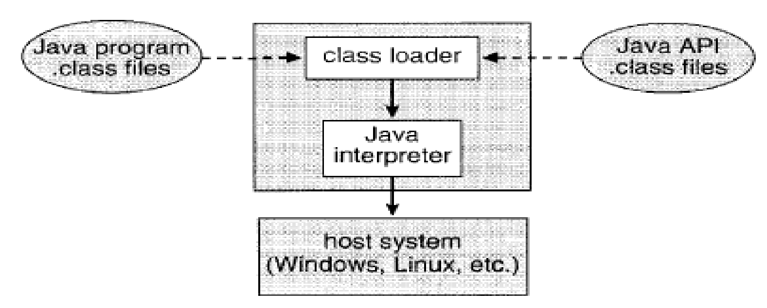
The Java Virtual Machine
Java is a popular object-oriented programming language introduced by Sun Microsystems in 1995.
In addition to a language specification and a large API library, Java also provides a specification for a Java virtual machine-or JVM.
Java objects are specified with the class construct; a Java program consists of one or more classes. For each Java class, the compiler produces an architecture-neutral bytecode output (. class) file that will run on any implementation of the JVM.
Dept. of ISE

Slide 128
The JVM is a specification for an abstract computer. It consists of a class loader and a Java interpreter that executes the architecture-neutral bytecodes, as diagrammed in Figure.
The class loader loads the compiled. Class files from both the Java program and the Java API for execution by the Java interpreter.
After a class is loaded, the verifier checks that the .class file is valid Java bytecode and does not overflow or underflow the stack.
It also ensures that the bytecode does not perform pointer arithmetic, which could provide illegal memory access. If the class passes verification, it is run by the Java interpreter.
The JVM also automatically manages memory by performing garbage collection-the practice of reclaiming memory from objects no longer in use and returning it to the system.
Dept. of ISE

Slide 129
Operating-System Generation
There are two approaches in which OS can be designed.
It is possible to design, code, and implement an operating system specifically for one machine at one site.
Operating systems are designed to run on any of a class of machines at a variety of sites with a variety of peripheral configurations.
The system must then be configured or generated for each specific computer site, a process sometimes known as system generation (SYSGEN) is used for this.
Dept. of ISE

Slide 130
The following kinds of information must be determined:
What CPU is to be used?
What options (extended instruction sets, floating point arithmetic, and so on) are installed? For multiple CPU systems, each CPU must be described.
How much memory is available?
What devices are available?
What operating-system options are desired, or what parameter values are to be used?
Dept. of ISE

Slide 131
System Boot
The procedure of starting a computer by loading the kernel is known as booting the system.
On most computer systems, a small piece of code known as the bootstrap program or bootstrap loader locates the kernel, loads it into main memory, and starts its execution.
This program is in the form of ROM, because the RAM is in an unknown state at system startup.
ROM is convenient because it needs no initialization and cannot be infected by a computer virus.
Dept. of ISE

Slide 132
When the full bootstrap program has been loaded, it can traverse the file system to find the OS kernel, load it into memory, and start its execution.
It is only at this point that the system is said to be running.
Process and threads
A process can be thought of as s process in execution.
A thread is the unit of execution within a process.
A Process can have one or more threads.
Dept. of ISE

Slide 133
The Process
A process is a program in execution.
A process is more than the program code, which is sometimes known as the text section.
It also includes the current activity, as represented by the value of the program counter and the contents of the processor's registers.
A process generally also includes the process stack, which contains temporary data (such as function parameters, return addresses, and local variables), and a data section, which contains global variables.
A process may also include a heap, which is memory that is dynamically allocated during process run time. The structure of a process in memory is shown in Figure.
Dept. of ISE

Slide 134
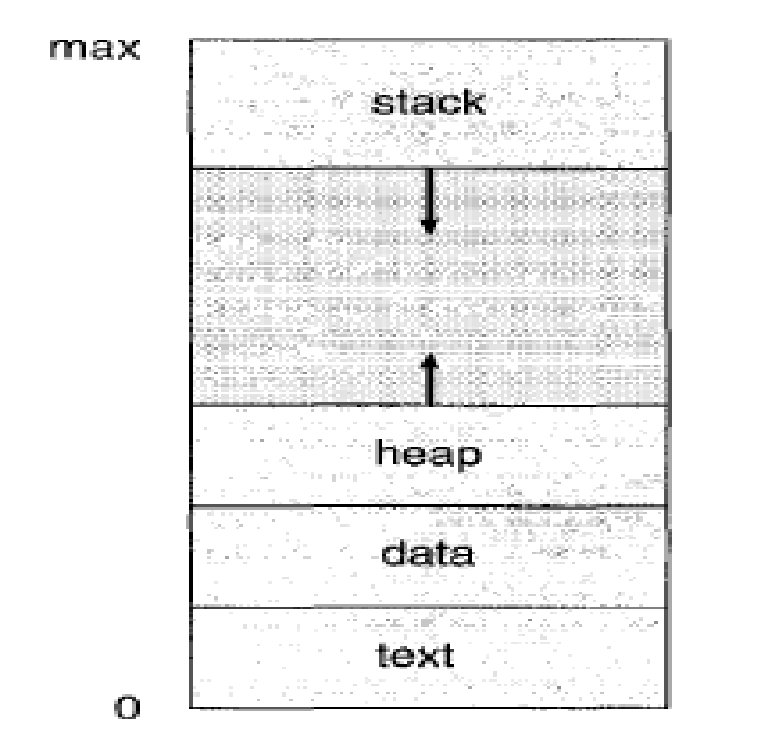
Dept. of ISE
Process in memory.

Slide 135
Process State
As a process executes, it changes state.
The state of a process is defined in part by the current activity of that process.
Each process may be in one of the following states:
New. The process is being created.
Running. Instructions are being executed.
Waiting. The process is waiting for some event to occur (such as an I/O completion or reception of a signal).
Ready. The process is waiting to be assigned to a processor.
Terminated. The process has finished execution.
Dept. of ISE

Slide 136
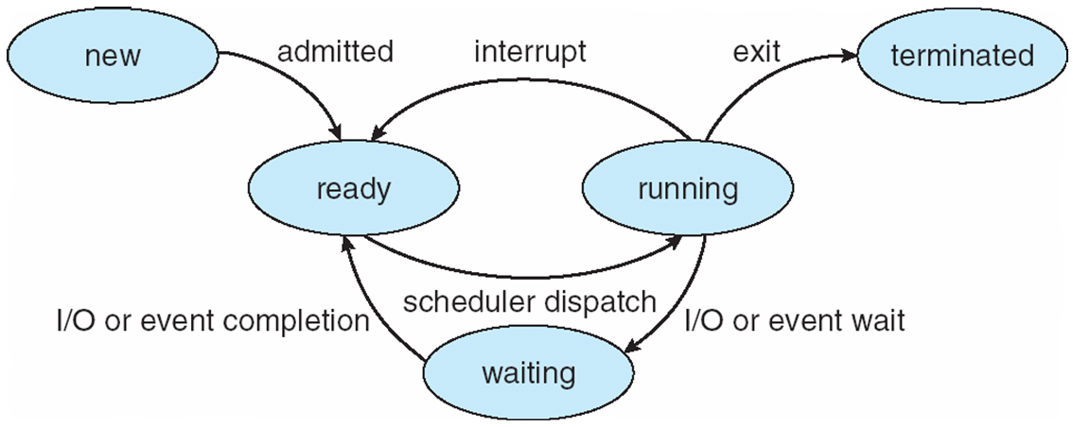
Dept. of ISE
Diagram of process states.

Slide 137
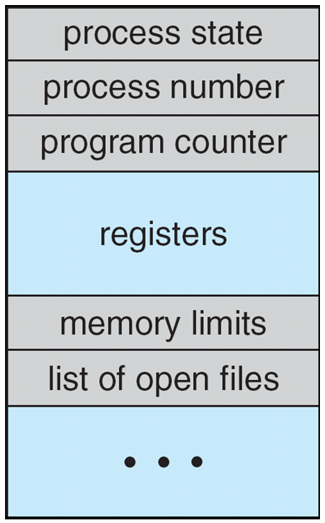
Process Control Block
Each process is represented in the operating system by a process control block (PCB) also called a task control block. A PCB is shown in Figure. It contains many pieces of information associated with a specific process, including these:
Dept. of ISE
Process control block (PCB).

Slide 138
Process state. The state may be new, ready, running, and waiting, halted, and so on.
Program counter. The counter indicates the address of the next instruction to be executed for this process.
CPU registers. The registers vary in number and type, depending on the computer architecture. They include accumulators, index registers, stack pointers, and general-purpose registers, plus any condition-code information. Along with the program counter, this state information must be saved when an interrupt occurs, to allow the process to be continued correctly afterward (Figure)
Dept. of ISE

Slide 139
CPU-scheduling information. This information includes a process priority, pointers to scheduling queues, and any other scheduling parameters.
Memory-management information. This information may include such information as the value of the base and limit registers, the page tables, or the segment tables, depending on the memory system used by the operating system.
Accounting information. This information includes the amount of CPU and real time used, time limits, account numbers, job or process numbers, and so on.
I/O status information. This information includes the list of I/O devices allocated to the process, a list of open files, and so on.

Slide 140
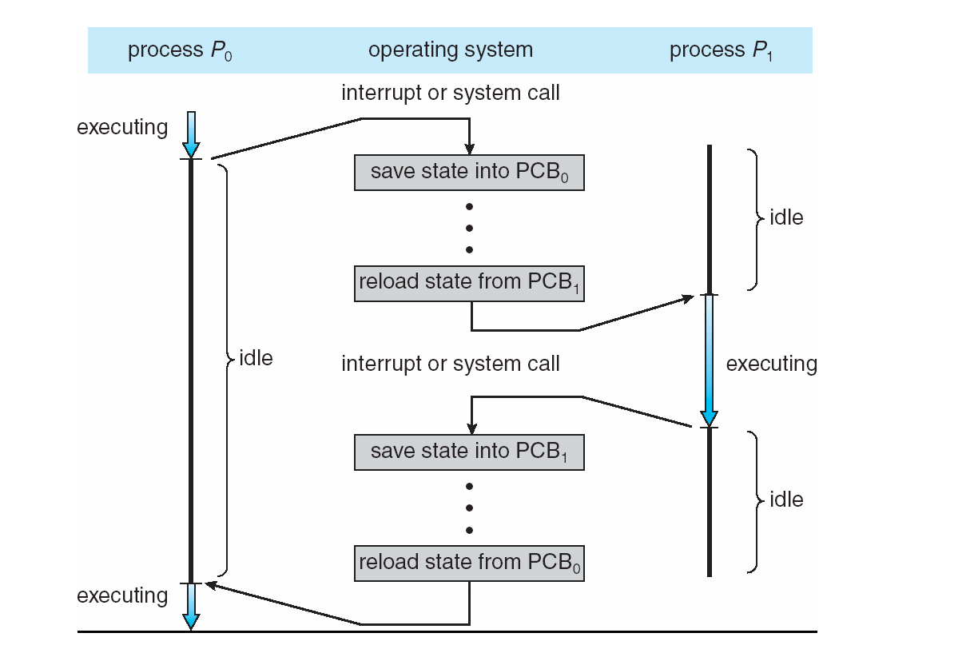
Dept. of ISE
Diagram showing CPU switch from process to process.

Slide 141
Context Switch
Interrupts cause the operating system to change a CPU from its current task and to run a kernel routine.
Such operations happen frequently on general-purpose systems.
When an interrupt occurs, the system needs to save the current context of the process currently running on the CPU so that it can restore that context when its processing is done, essentially suspending the process and then resuming it.
The context is represented in the PCB of the process; it includes the value of the CPU registers, the process state, and memory- management information. Generically, we perform a state save of the current state of the CPU, be it in kernel or user mode, and then a state restore to resume operations.
Dept. of ISE

Slide 142
Switching the CPU to another process requires performing a state save of the current process and a state restore of a different process.
This task is known as context switch
Context switch time is pure overhead, because the system does no useful work while switching.
Its speed varies from machine to machine, depending on the memory speed, the number of registers that must be copied, and the existence of special instructions (such as a single instruction to load or store all registers.
Typically speed are few milliseconds.
Dept. of ISE

Slide 143
Process Scheduling
The objective of multiprogramming is to have some process running at all times, to maximize CPU utilization.
The objective of time sharing is to switch the CPU among processes so frequently that users can interact with each program while it is running.
To meet these objectives, the process scheduler selects an available process (possibly from a set of several available processes) for program execution on the CPU.
For a single-processor system, there will never be more than one running process. If there are more processes, the rest will have to wait until the CPU is free and can be rescheduled.
Dept. of ISE

Slide 144
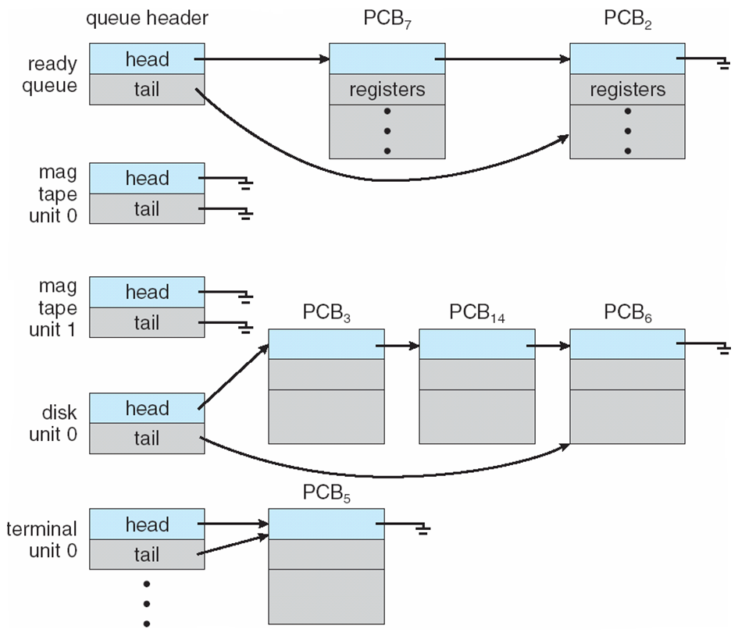
Dept. of ISE
The ready queue and various I/O device queues.

Slide 145
As processes enter the system, they are put into a job queue, which consists of all processes in the system.
The processes that are residing in main memory and are ready and waiting to execute are kept on a list called the ready queue.
This queue is generally stored as a linked list.
A ready-queue header contains pointers to the first and final PCBs in the list. Each PCB includes a pointer field that points to the next PCB in the ready queue.
Dept. of ISE

Slide 146
Suppose the process makes an I/O request to a shared device, such as a disk.
Since there are many processes in the system, the disk may be busy with the I/O request of some other process.
The process therefore may have to wait for the disk. The list of processes waiting for a particular I/O device is called a device queue.
Each device has its own device queue.
A common representation for a discussion of process scheduling is a queueing diagram, such as that in Figure.
Each rectangular box represents a queue.
Two types of queues are present: the ready queue and a set of device queues.
Dept. of ISE

Slide 147
The circles represent the resources that serve the queues, and the arrows indicate the flow of processes in the system.
A new process is initially put in the ready queue. It waits there until it is selected for execution, or is dispatched.
Once the process is allocated the CPU and is executing, one of several events could occur:
The process could issue an I/O request and then be placed in an I/O queue.
The process could create a new subprocess and wait for the subprocess's termination.
The process could be removed forcibly from the CPU, as a result of an interrupt, and be put back in the ready queue.
Dept. of ISE

Slide 148
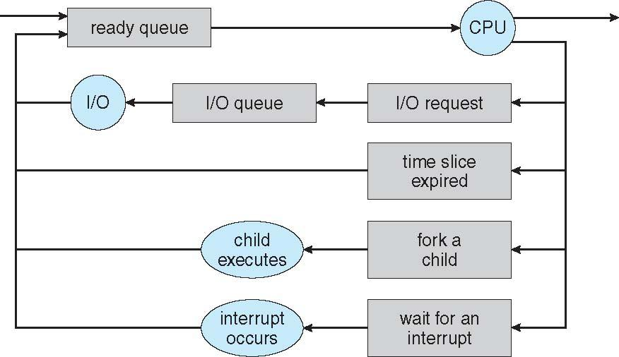
Dept. of ISE
Queueing-diagram representation of process scheduling

Slide 149
Schedulers
A process migrates among the various scheduling queues throughout its lifetime. The operating system must select, for scheduling purposes, processes from these queues in some fashion. The selection process is carried out by the appropriate scheduler.
In a batch system, more processes are submitted than can be executed immediately. These processes are spooled to a mass-storage device (typically a disk), where they are kept for later execution.
The long-term scheduler, or job scheduler, selects processes from this pool and loads them into memory for execution.
The short-term scheduler, or CPU scheduler, selects from among the processes that are ready to execute and allocates the CPU to one of them.
Dept. of ISE

Slide 150
The primary distinction between these two schedulers lies in frequency of execution.
The short-term scheduler must select a new process for the CPU frequently. A process may execute for only a few milliseconds before waiting for an I/O request.
The short-term scheduler executes at least once every 100 milliseconds. Because of the short time between executions, the short-term scheduler must be fast.
Some operating systems, such as time-sharing systems, may introduce an additional, intermediate level of scheduling.
This medium-term scheduler is diagrammed in Figure.
The key idea behind a medium-term scheduler is that sometimes it can be advantageous to remove processes from memory and thus reduce the degree of multiprogramming.
The process can be reintroduced into memory, and its execution can be continued where it left off. This scheme is called swapping.
Dept. of ISE

Slide 151
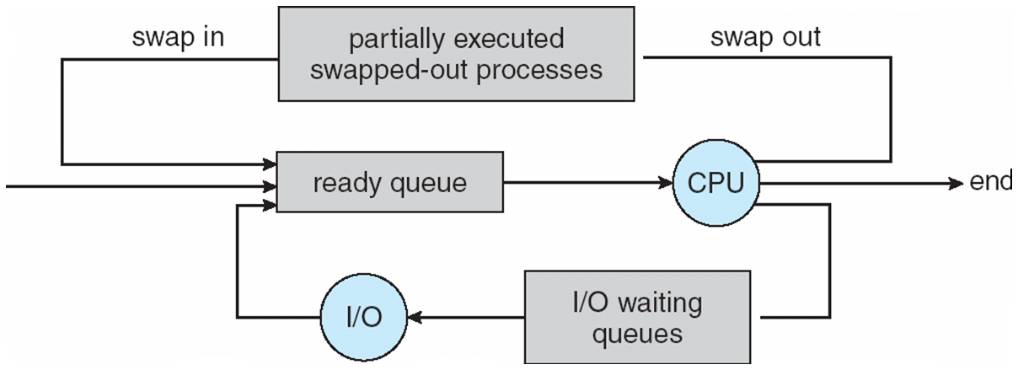
Dept. of ISE
Addition of medium-term scheduling to the queueing diagram.

Slide 152
TYPES OF SCHEDULER
Long Term Scheduler | Short term schedular | Medium Term Scheduler
It is a job scheduler | It is a CPU scheduler | It is a process-swapping scheduler.
Generally, Speed is lesser than short term scheduler | Speed is the fastest among all of them. | Speed lies in between both short and long-term schedulers.
It controls the degree of multiprogramming | It gives less control over how much multiprogramming is done. | It reduces the degree of multiprogramming.
It is barely present or nonexistent in the time-sharing system. | It is a minimal time-sharing system. | It is a component of systems for time sharing.
It can re-enter the process into memory, allowing for the continuation of execution. | It selects those processes which are ready to execute | It can re-introduce the process into memory and execution can be continued.
Dept. of ISE

Slide 153
Operations on Processes
The processes in most systems can execute concurrently, and they may be created and deleted dynamically. Thus, these systems must provide a mechanism for process creation and termination.
Process Creation
A process may create several new processes, via a create-process system call during the course of execution.
The creating process is called a parent process, and the new processes are called the children of that process.
Each of these new processes may in turn create other processes, forming a tree of processes.
Dept. of ISE

Slide 154
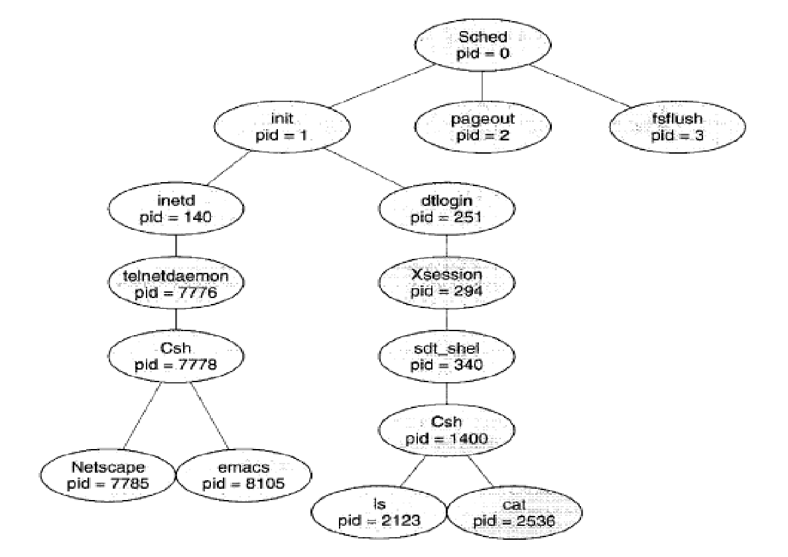
Dept. of ISE
A tree of processes on a typical Solaris system.

Slide 155
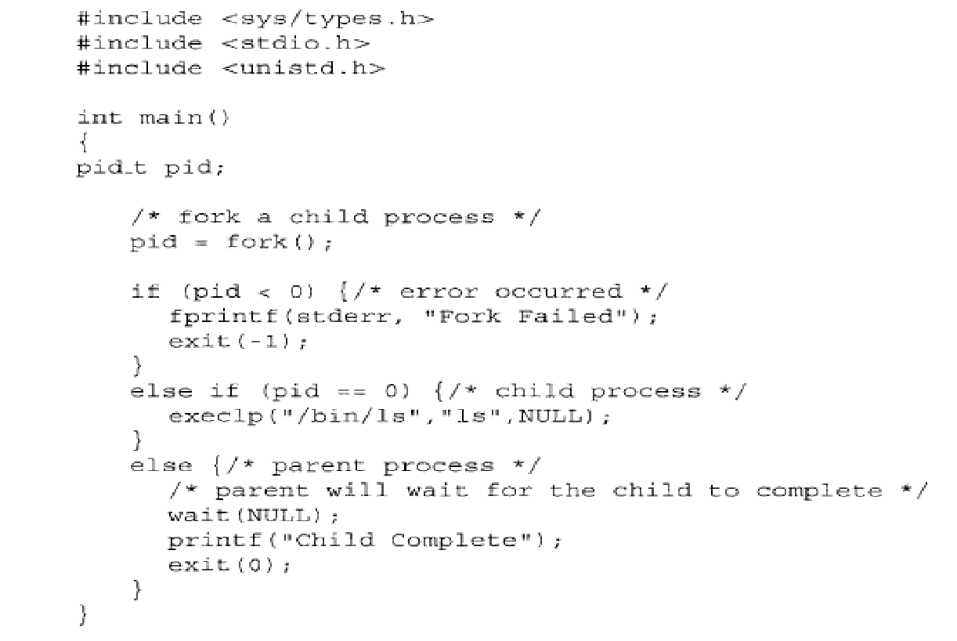
To illustrate these differences, let's first consider the UNIX operating system. In UNIX, as we've seen, each process is identified by its process identifier,
Dept. of ISE
C program forking a separate process.

Slide 156
When a process creates a new process, two possibilities exist in terms of execution:
1. The parent continues to execute concurrently with its children.
2. The parent waits until some or all of its children have terminated.
There are also two possibilities in terms of the address space of the new process:
1. The child process is a duplicate of the parent process (it has the same program and data as the parent).
2. The child process has a new program loaded into it.
Dept. of ISE

Slide 157
The C program shown in Figure 1.35 illustrates the UNIX system calls previously described. We now have two different processes running a copy of the same program. The value of pid for the child process is zero; that for the parent is an integer value greater than zero. The child process overlays its address space with the UNIX command /bin/ls (used to get a directory listing) using the execlp ( ) system call (execlp ( ) is a version of the exec ( ) system call).
The parent waits for the child process to complete with the wait ( ) system call. When the child process completes (by either implicitly or explicitly invoking exit (0) the parent process resumes from the call to wait ( ), where it completes using the exit ( ) system call. This is also illustrated in Figure 1.36.
Dept. of ISE

Slide 158
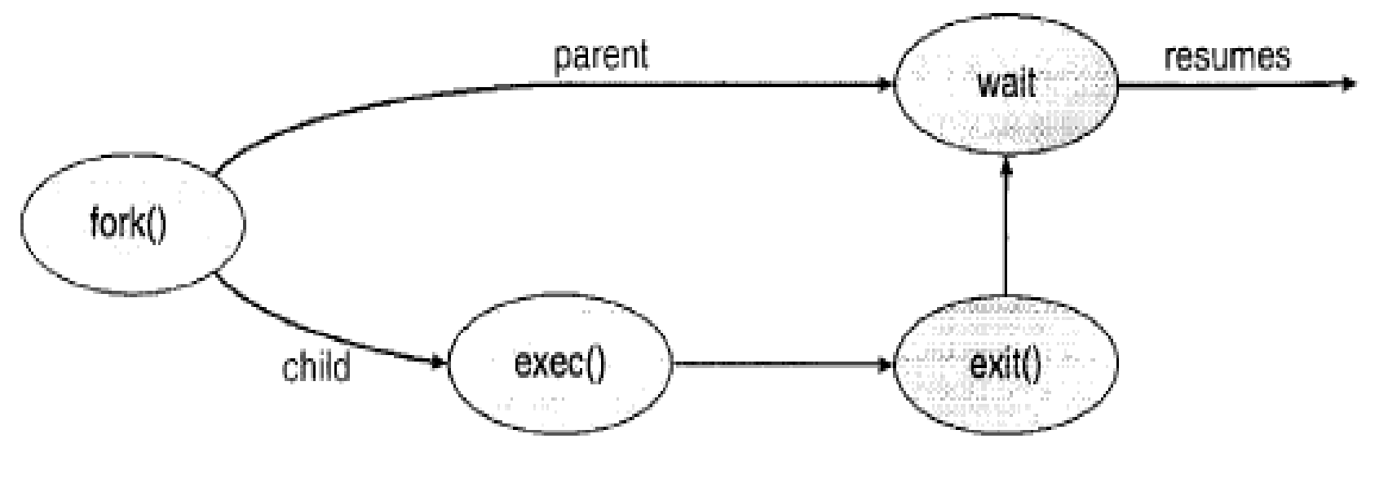
Dept. of ISE
Process Creation.

Slide 159
Process Termination
A process terminates when it finishes executing its final statement and asks the operating system to delete it by using the exit () system call.
At that point, the process may return a status value (typically an integer) to its parent process (via the wait ( ) system call).
All the resources of the process-including physical and virtual memory, open files, and I/O buffers-are deallocated by the operating system.
Termination can occur in other circumstances as well.
A process can cause the termination of another process via an appropriate system call.
Usually, such a system call can be invoked only by the parent of the process that is to be terminated.
Dept. of ISE

Slide 160
Otherwise, users could arbitrarily kill each other's jobs.
A parent may terminate the execution of one of its children for a variety of reasons, such as these:
The child has exceeded its usage of some of the resources that it has been allocated. (To determine whether this has occurred, the parent must have a mechanism to inspect the state of its children.)
The task assigned to the child is no longer required.
The parent is exiting, and the operating system does not allow a child to continue if its parent terminates.
Dept. of ISE

Slide 161
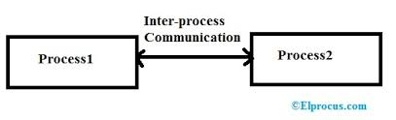
Interprocess Communication
Processes executing concurrently in the operating system may be either independent processes or cooperating processes.
A process is independent if it cannot affect or be affected by the other processes executing in the system.
A process is cooperating if it can affect or be affected by the other processes executing in the system.
Clearly, any process that shares data with other processes is a cooperating process.
Dept. of ISE

Slide 162
There are several reasons for providing an environment that allows process cooperation:
Information sharing. Since several users may be interested in the same piece of information (for instance, a shared file), we must provide an environment to allow concurrent access to such information.
Computation speedup. If we want a particular task to run faster, we must break it into subtasks, each of which will be executing in parallel with the others. Notice that such a speedup can be achieved only if the computer has multiple processing elements (such as CPUs or I/O channels).
Modularity. We may want to construct the system in a modular fashion, dividing the system functions into separate processes or threads.
Dept. of ISE

Slide 163
Convenience. Even an individual user may work on many tasks at the same time. For instance, a user may be editing, printing, and compiling in parallel.
Cooperating processes require an interprocess communication (IPC) mechanism that will allow them to exchange data and information.
There are two fundamental models of interprocess communication:
(1) Shared memory.
(2) Message passing.
Dept. of ISE

Slide 164
In the shared-memory model, a region of memory that is shared by cooperating processes is established.
Processes can then exchange information by reading and writing data to the shared region.
In the message passing model, communication takes place by means of messages exchanged between the cooperating processes.
Dept. of ISE

Slide 165
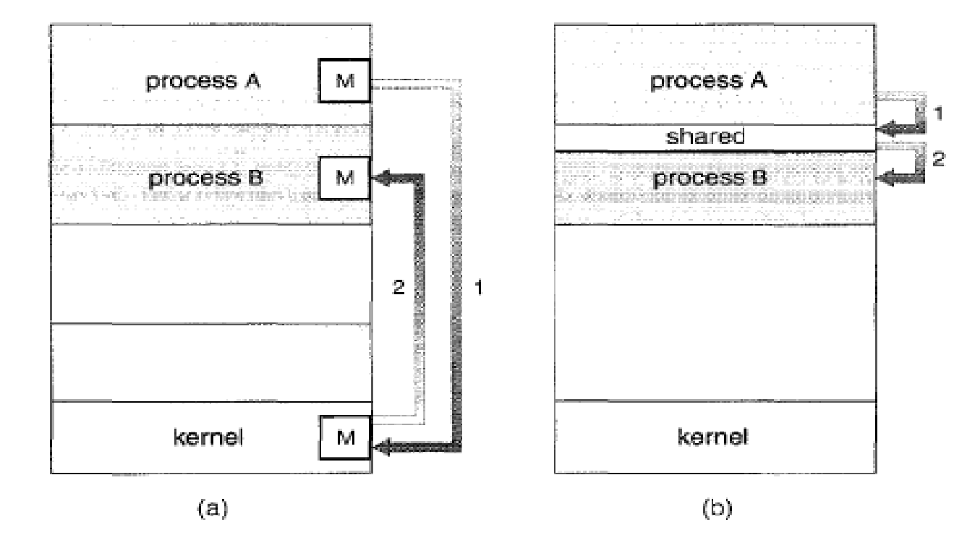
Dept. of ISE
Communication models (a) Message passing (b) Shared memory.

Slide 166
Shared-Memory Systems
Interprocess communication using shared memory requires communicating processes to establish a region of shared memory.
Typically, a shared-memory region resides in the address space of the process creating the shared-memory segment.
Other processes that wish to communicate using this shared-memory segment must attach it to their address space.
Dept. of ISE

Slide 167
Normally, the operating system tries to prevent one process from accessing another process's memory.
Shared memory requires that two or more processes agree to remove this restriction.
They can then exchange information by reading and writing data in the shared areas.
Dept. of ISE

Slide 168
One solution to the producer-consumer problem uses shared memory.
To allow producer and consumer processes to run concurrently, we must have available a buffer of items that can be filled by the producer and emptied by the consumer.
This buffer will reside in a region of memory that is shared by the producer and consumer processes.
A producer can produce one item while the consumer is consuming another item.
Dept. of ISE

Slide 169
The producer and consumer must be synchronized, so that the consumer does not try to consume an item that has not yet been produced.
Two types of buffers can be used.
The unbounded buffer places no practical limit on the size of the buffer. The consumer may have to wait for new items, but the producer can always produce new items.
The bounded buffer assumes a fixed buffer size. In this case, the consumer must wait if the buffer is empty, and the producer must wait if the buffer is full.

Slide 170
Message-Passing Systems
Message passing provides a mechanism to allow processes to communicate and to synchronize their actions without sharing the same address space and is particularly useful in a distributed environment, where the communicating processes may reside on different computers connected by a network.
For example, a chat program used on the World Wide Web could be designed so that chat participants communicate with one another by exchanging messages.
Dept. of ISE

Slide 171
A message-passing facility provides at least two operations:
send (message) and receive (message).
Messages sent by a process can be of either fixed or variable size.
If only fixed-sized messages can be sent, the system-level implementation is straightforward. But makes the task of programming more difficult.
Variable-sized messages require a more complex system-level implementation, but the programming task becomes simpler.
Dept. of ISE

Slide 172
If processes P and Q want to communicate, they must send messages to and receive messages from each other; a communication link must exist between them.
This link can be implemented in a variety of ways. We are concerned here not with the link's physical implementation but rather with its logical implementation. Here are several methods for logically implementing a link and the send ( ) /receive ( ) operations:
Direct or indirect communication.
Synchronous or asynchronous communication.
Automatic or explicit buffering.
There are several issues related with features like: Naming, Synchronization, Buffering.
Dept. of ISE

Slide 173
Naming
Processes that want to communicate must have a way to refer to each other. They can use either direct or indirect communication.
Under direct communication, each process that wants to communicate must explicitly name the recipient or sender of the communication.
Send (P, message) -Send a message to process P.
Receive (Q, message) -Receive a message from process Q.
Dept. of ISE

Slide 174
A communication link in this scheme has the following properties:
A link is established automatically between every pair of processes that want to communicate. The processes need to know only each other's identity to communicate
A link is associated with exactly two processes.
Between each pair of processes, there exists exactly one link.
Dept. of ISE
This scheme exhibits symmetry in addressing, that is both the sender process and the receiver process must name the other to communicate

Slide 175
Another variant of direct communication:-Here ,only the sender names the recipient ; the recipient is not required to name the sender.
Send (P , message) - send a message to process P
Receive (id, message) – Receive a message from any process; the variable id is set to the name of the process with which communication has taken place.
This scheme employs asymmetry in addressing.
The disadvantage in both of these schemes (symmetric and asymmetric) is the limited modularity of the resulting process definitions. Changing the identifier of a process may necessitate examining all other process definitions.
Dept. of ISE

Slide 176
Indirect communication
The messages are sent to and received from mailboxes, or ports.
A mailbox can be viewed abstractly as an object into which messages can be placed by processes and from which messages can be removed.
Each mailbox has a unique identification.
Two processes can communicate only if the processes have a shared mailbox.
The send ( ) and receive ( ) primitives are defined as follows:
Send (A, message) -Send a message to mailbox A.
Receive (A, message) -Receive a message from mailbox A.
Dept. of ISE

Slide 177
In this scheme, a communication link has the following properties:
A link is established between a pair of processes only if both members of the pair have a shared mailbox.
A link may be associated with more than two processes.
Between each pair of communicating processes, there may be a number of different links, with each link corresponding to one mailbox.
Now suppose that processes P1, P2 and P3 all share mailbox A
Process P1 sends a message to A while both P2 and P3 execute a receive() from A Which process will receive the message sent by P1
Answer depends on which of the following methods we choose
Dept. of ISE

Slide 178
Allow link to be associated with two processes at most.
Allow at most one process at a time to execute a receive() operation.
Allow the system to select arbitrarily which process will receive the message(either p2 or p3 but not both will receive the message)
The system also may define an algorithm for selecting which process will receive message(round robin where processes takes turns receiving messages)
The system may identify the receiver to sender
A mail box may be owned either by a process or by the OS.
Dept. of ISE

Slide 179
Synchronization
Communication between processes takes place through calls to send ( ) and receive ( ) primitives. There are different design options for implementing each primitive.
Message passing may be either blocking or nonblocking also known as synchronous and asynchronous.
Blocking send. The sending process is blocked until the message is received by the receiving process or by the mailbox.
Nonblocking send. The sending process sends the message and resumes operation.
Blocking receive. The receiver blocks until a message is available.
Nonblocking receive. The receiver retrieves either a valid message or a null.
Dept. of ISE

Slide 180
Buffering
Whether communication is direct or indirect, messages exchanged by communicating processes reside in a temporary queue. Basically, such queues can be implemented in three ways:
Zero capacity. The queue has a maximum length of zero; thus, the link cannot have any messages waiting in it. In this case, the sender must block until the recipient receives the message.
Dept. of ISE

Slide 181
Bounded capacity. The queue has finite length n; thus, at most n messages can reside in it. If the queue is not full when a new message is sent, the message is placed in the queue (either the message is copied or a pointer to the message is kept), and the sender can continue execution without waiting. The links capacity is finite, however. If the link is full, the sender must block until space is available in the queue.
Unbounded capacity. The queues length is potentially infinite; thus, any number of messages can wait in it. The sender never blocks.
Dept. of ISE

Slide 182
THANK YOU
Dept. of ISE

